Slide 1
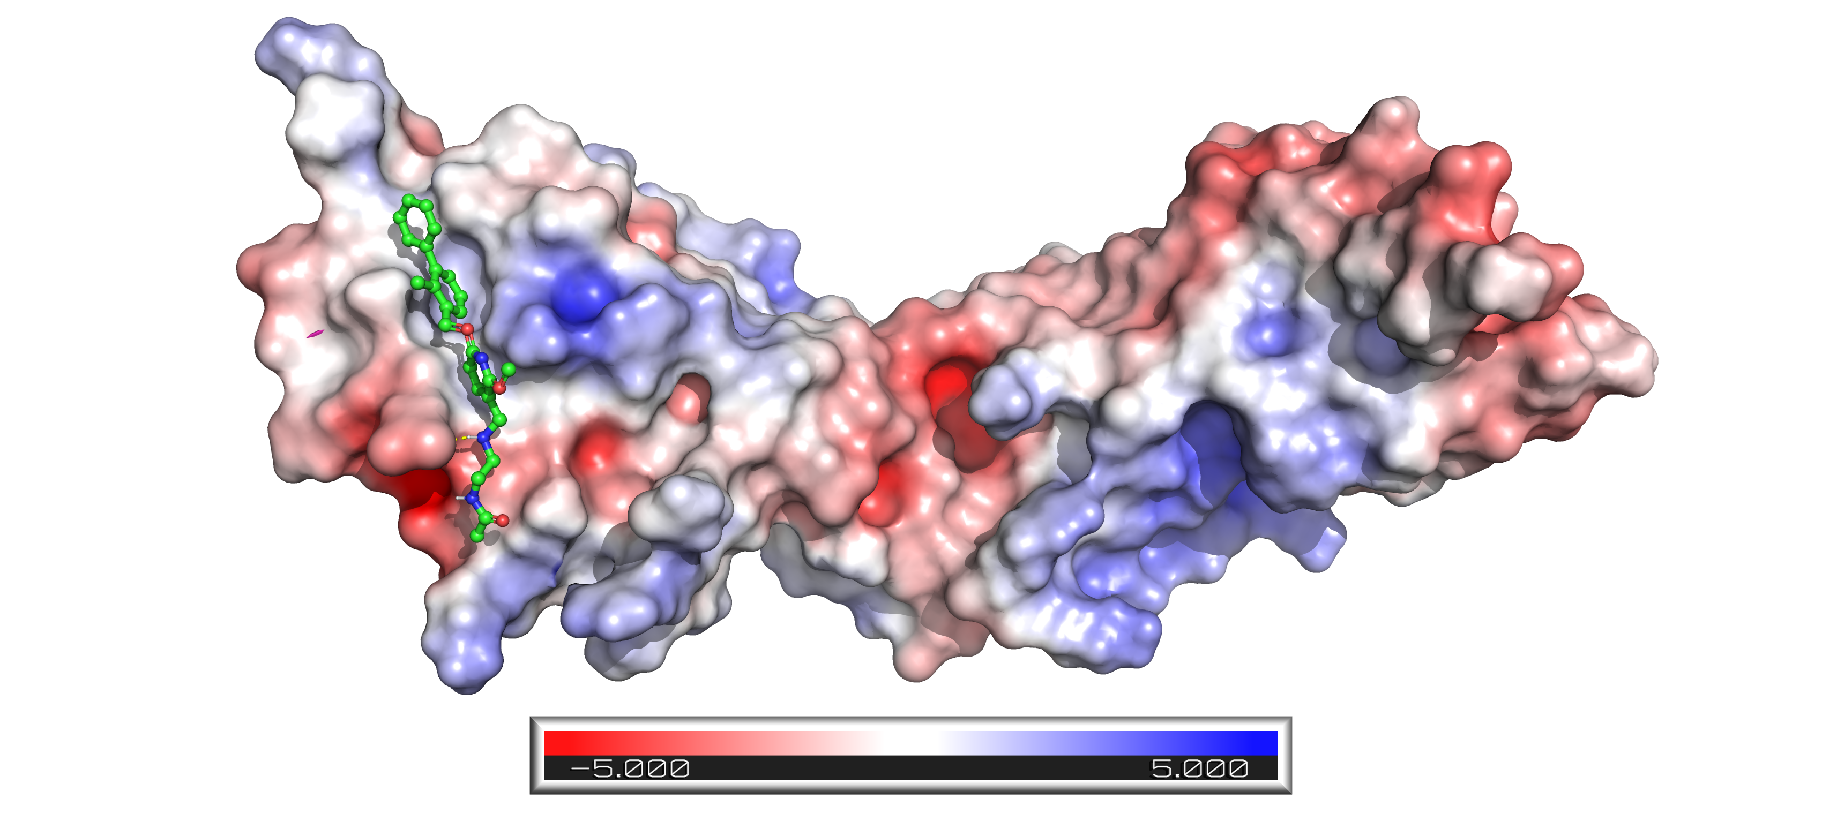
Decoding the inhibition selectivity and physicochemical multiverse of beta-carbonic anhydrase inhibitors through random forest and neural network-assisted QSAR/QSAAR modeling: A novel approach for the rational design of new anti-tuberculosis drugs
Principle Investigator: Dr. Ashok Aspatwar
ML Model Generation and Optimization/Software Development/Chemical Data Curation/ Molecular Modeling Studies: Ratul Bhowmik
Co-authors: Ajay Manaithiya, Rajarshi Ray
Affiliation: Tampere University, Finland

Slide 2
PRIMARY OBJECTIVES
Generation of selective robust multi-molecular signature implemented machine learning-assisted quantitative structural activity relationship (ML-QSAR) models for predicting bioactivity (Ki) against MtbCA1 and MtbCA2
Structural interpretation of active and inactive molecules concerning MtbCA1 and MtbCA2 inhibition through variance importance plot, correlation matrix, and feature plot analysis
Development of a web application using the generated ML-QSAR models
Generation of neural network-assisted quantitative structural activity-activity relationship (ML-QSAAR) models to infer the structural-functional correlation between MtbCA1 and MtbCA2 inhibitor’s binding mechanism
Validation of key molecular signatures extracted from ML-QSAR and ML-QSAAR analysis through molecular docking approach

Slide 3
MtbCA1 Exploratory Data Analysis

Slide 4
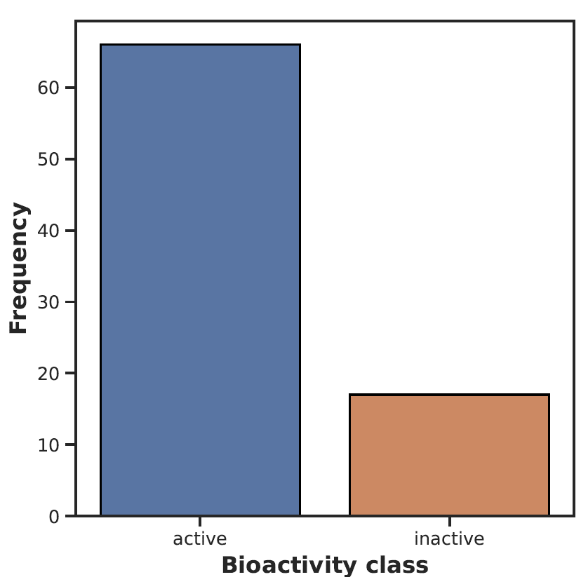
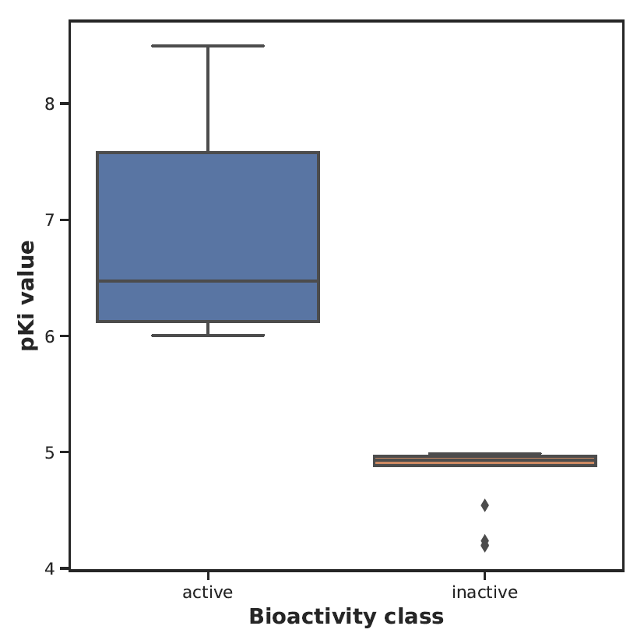

Slide 5
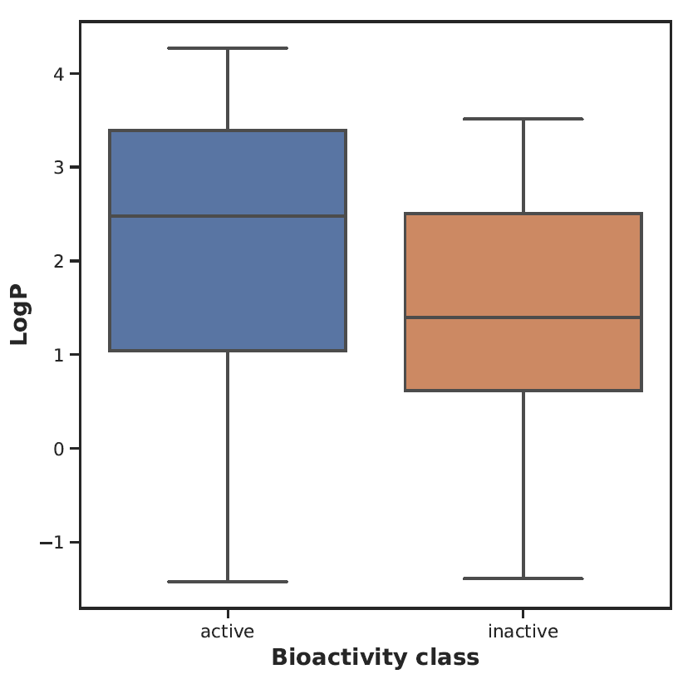
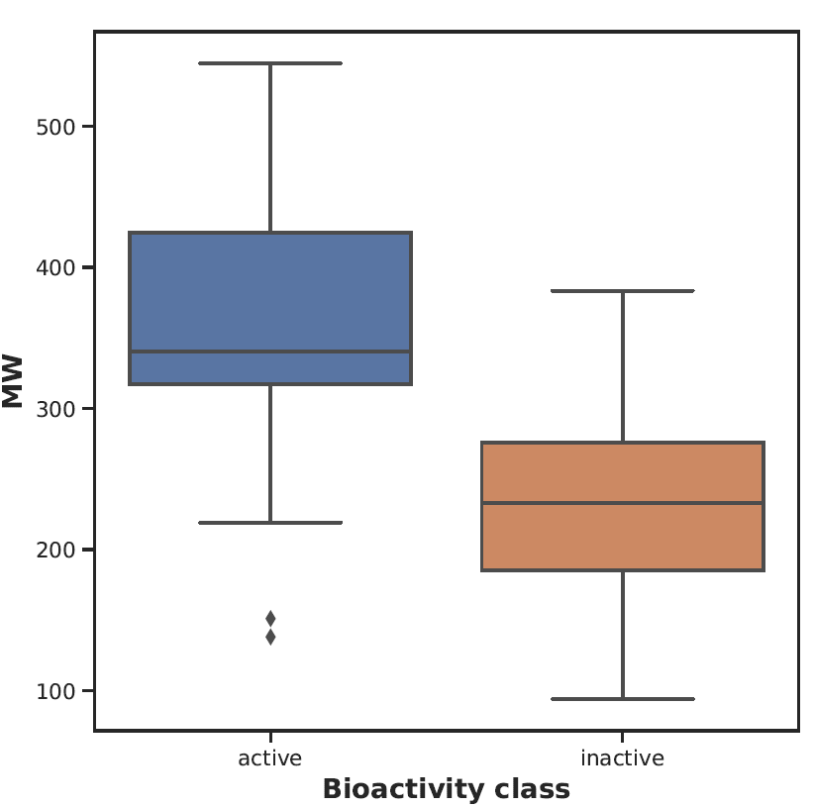

Slide 6
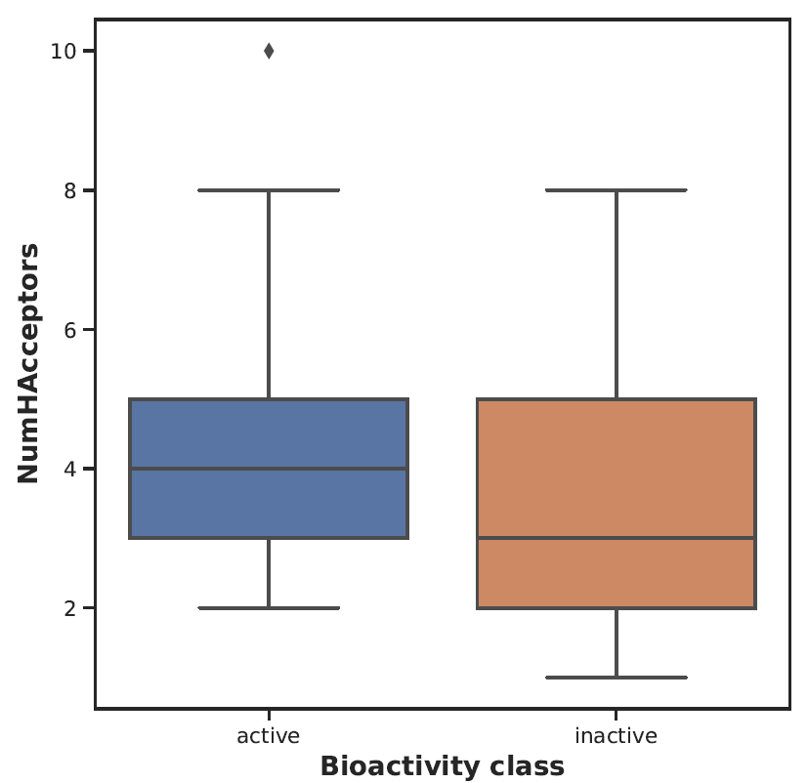
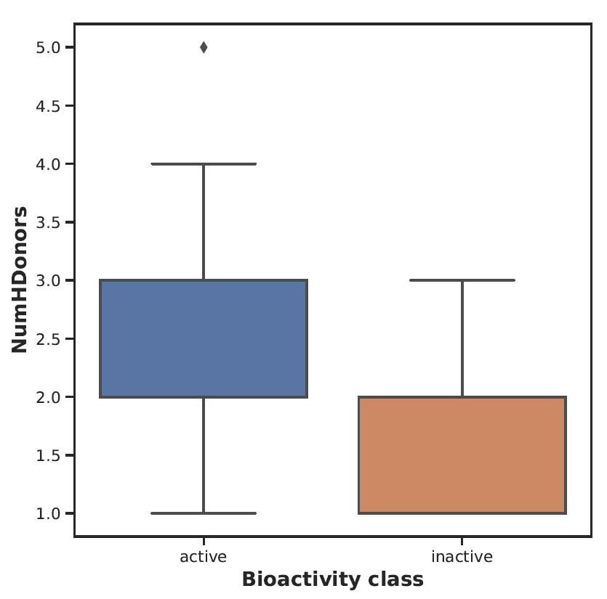

Slide 7
MtbCA2 Exploratory Data Analysis

Slide 8
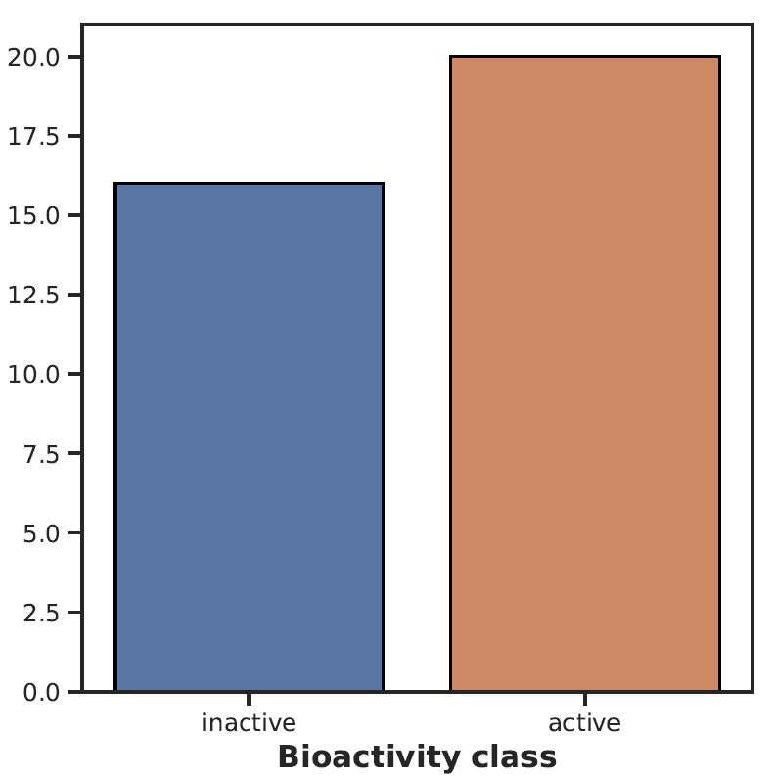
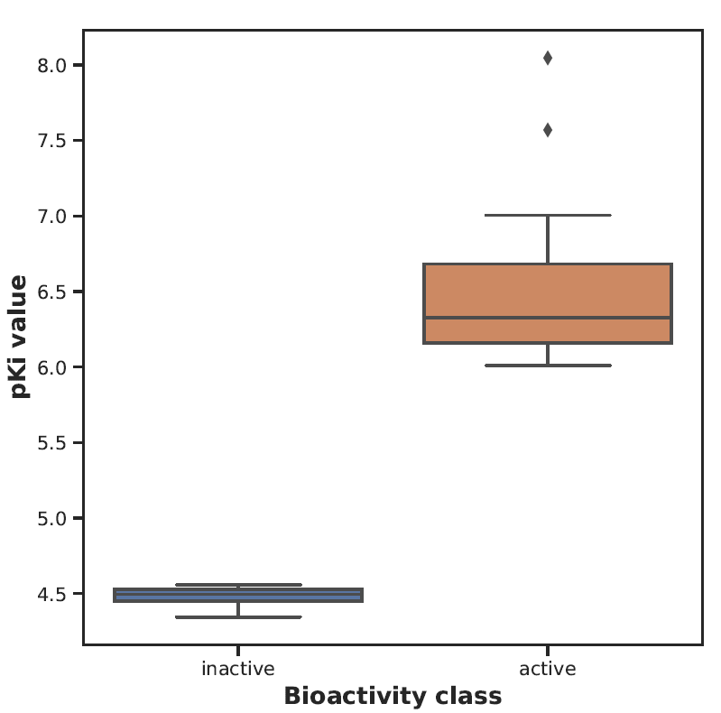
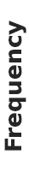

Slide 9
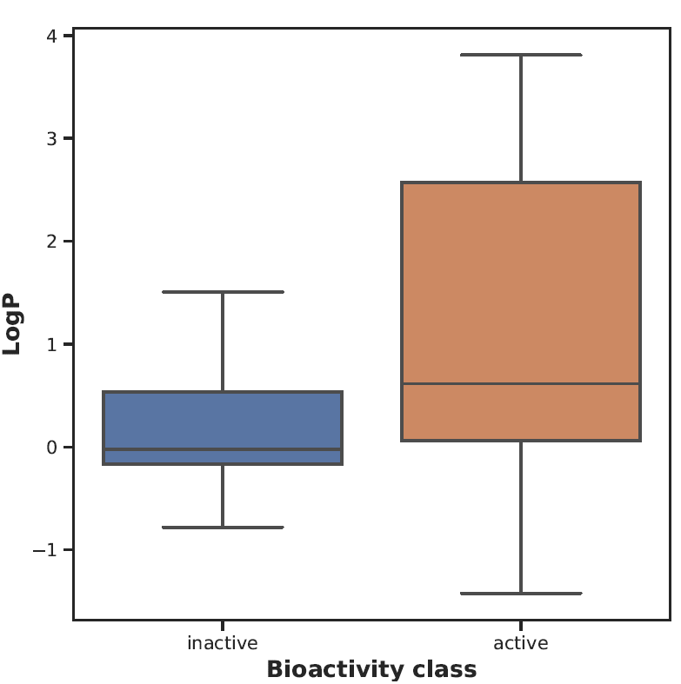
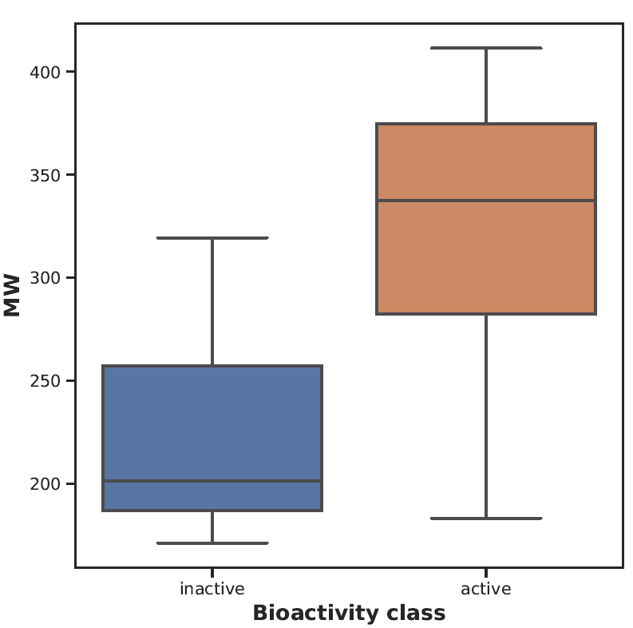

Slide 10
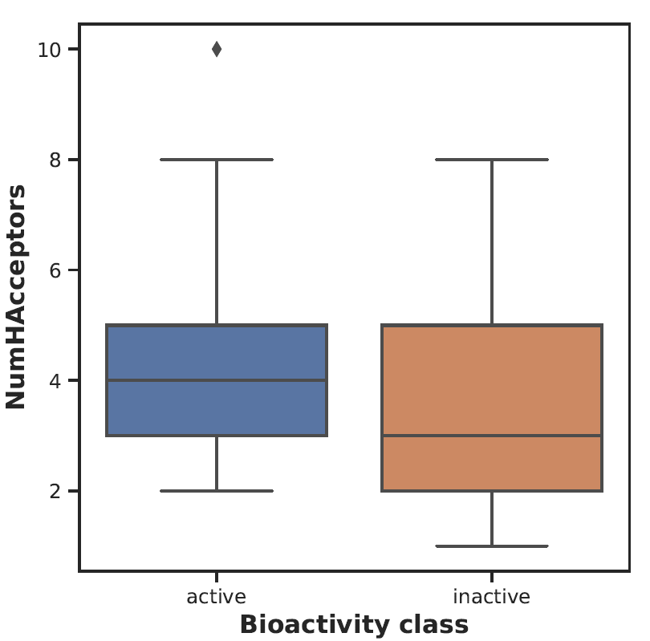

Slide 11
MACHINE LEARNING ASSISTED QUANTITATIVE STRUCTURAL ACTIVITY RELATIONSHIP

Slide 12
MtbCA1 Prediction Model

Slide 13

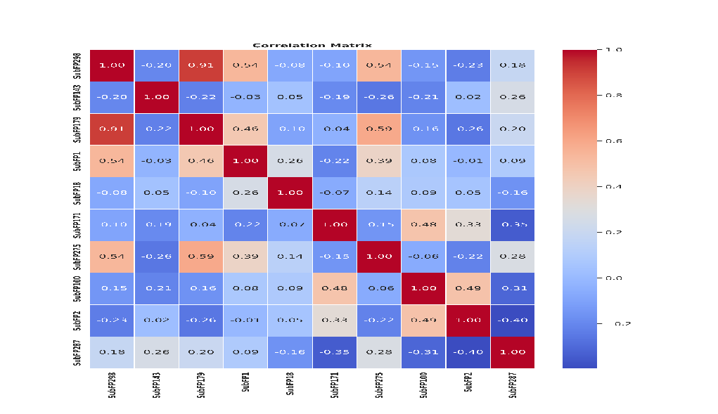
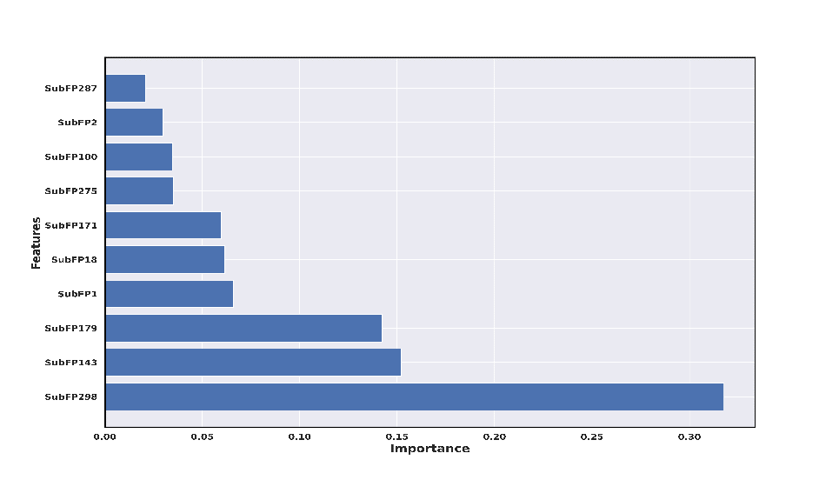

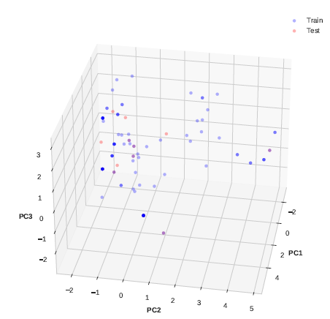
ML-QSAR model for bioactivity prediction of MtbCA1 inhibitors using substructure fingerprints
Model Metrics
R2 (Train: 0.955, Test: 0.9406)
RMSE (Train: 0.3073,
Test: 0.5725)
MAE (Train: 0.2367, Test: 0.4899)
Correlation Matrix
Curation of MtbCA1 inhibitors with Ki value
Final Model Performance
Prediction Parameter: Bioactivity Class
(‘pKi’)
VIP Plot
The final machine-learning model
Total inhibitors:124
Substructure fingerprints:
307
number of molecules in training(89) and test(14)
Dataset Splitting into training and test set
Elimination of highly correlated and constant fingerprints
Validation Metrics
Final number of fingerprints(18), number of molecules in training(99) and test(25)
Random Forest Regressor
Model Metrics
R2 (Train: 0.8853, Test: 0.7371)
RMSE (Train: 0.5084, Test: 0.8106)
MAE (Train: 0.3549, Test: 0.7171)
FP and FN Removal
Initial Model Performance
Mention molecules removed (21)
Applicability Domain Analysis

Slide 14
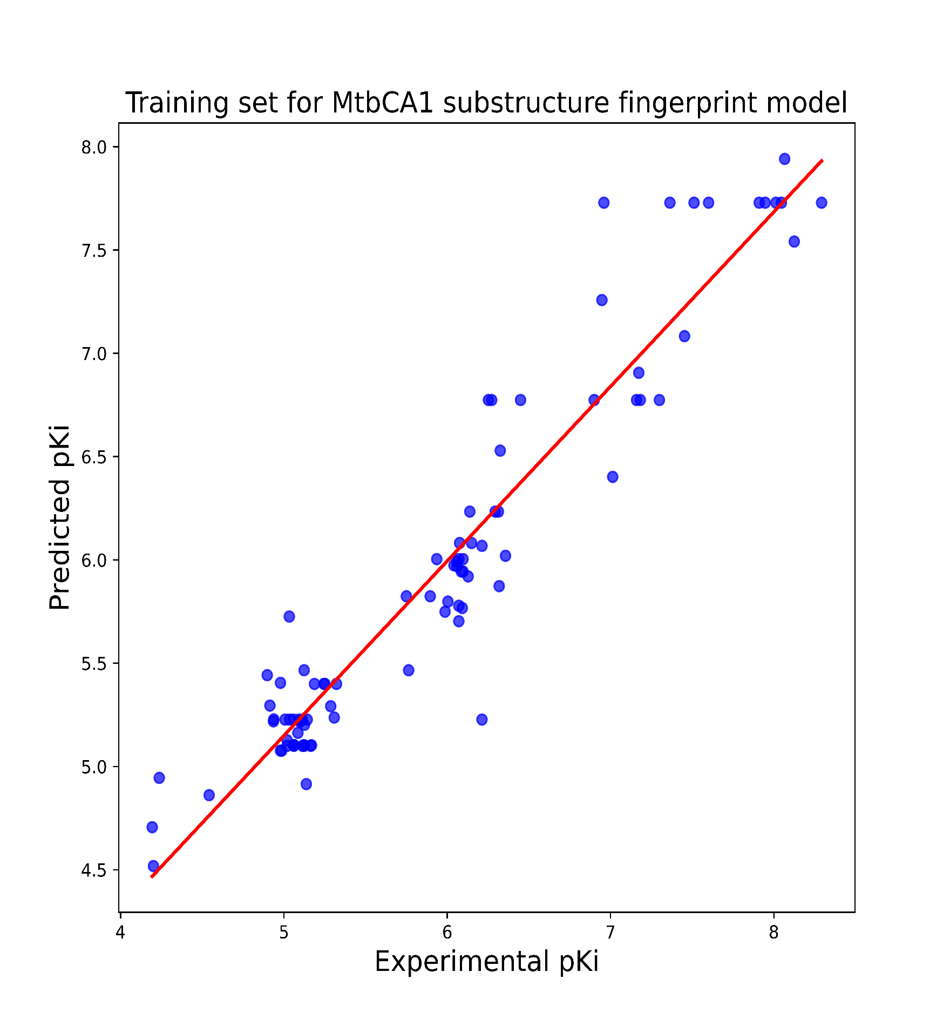
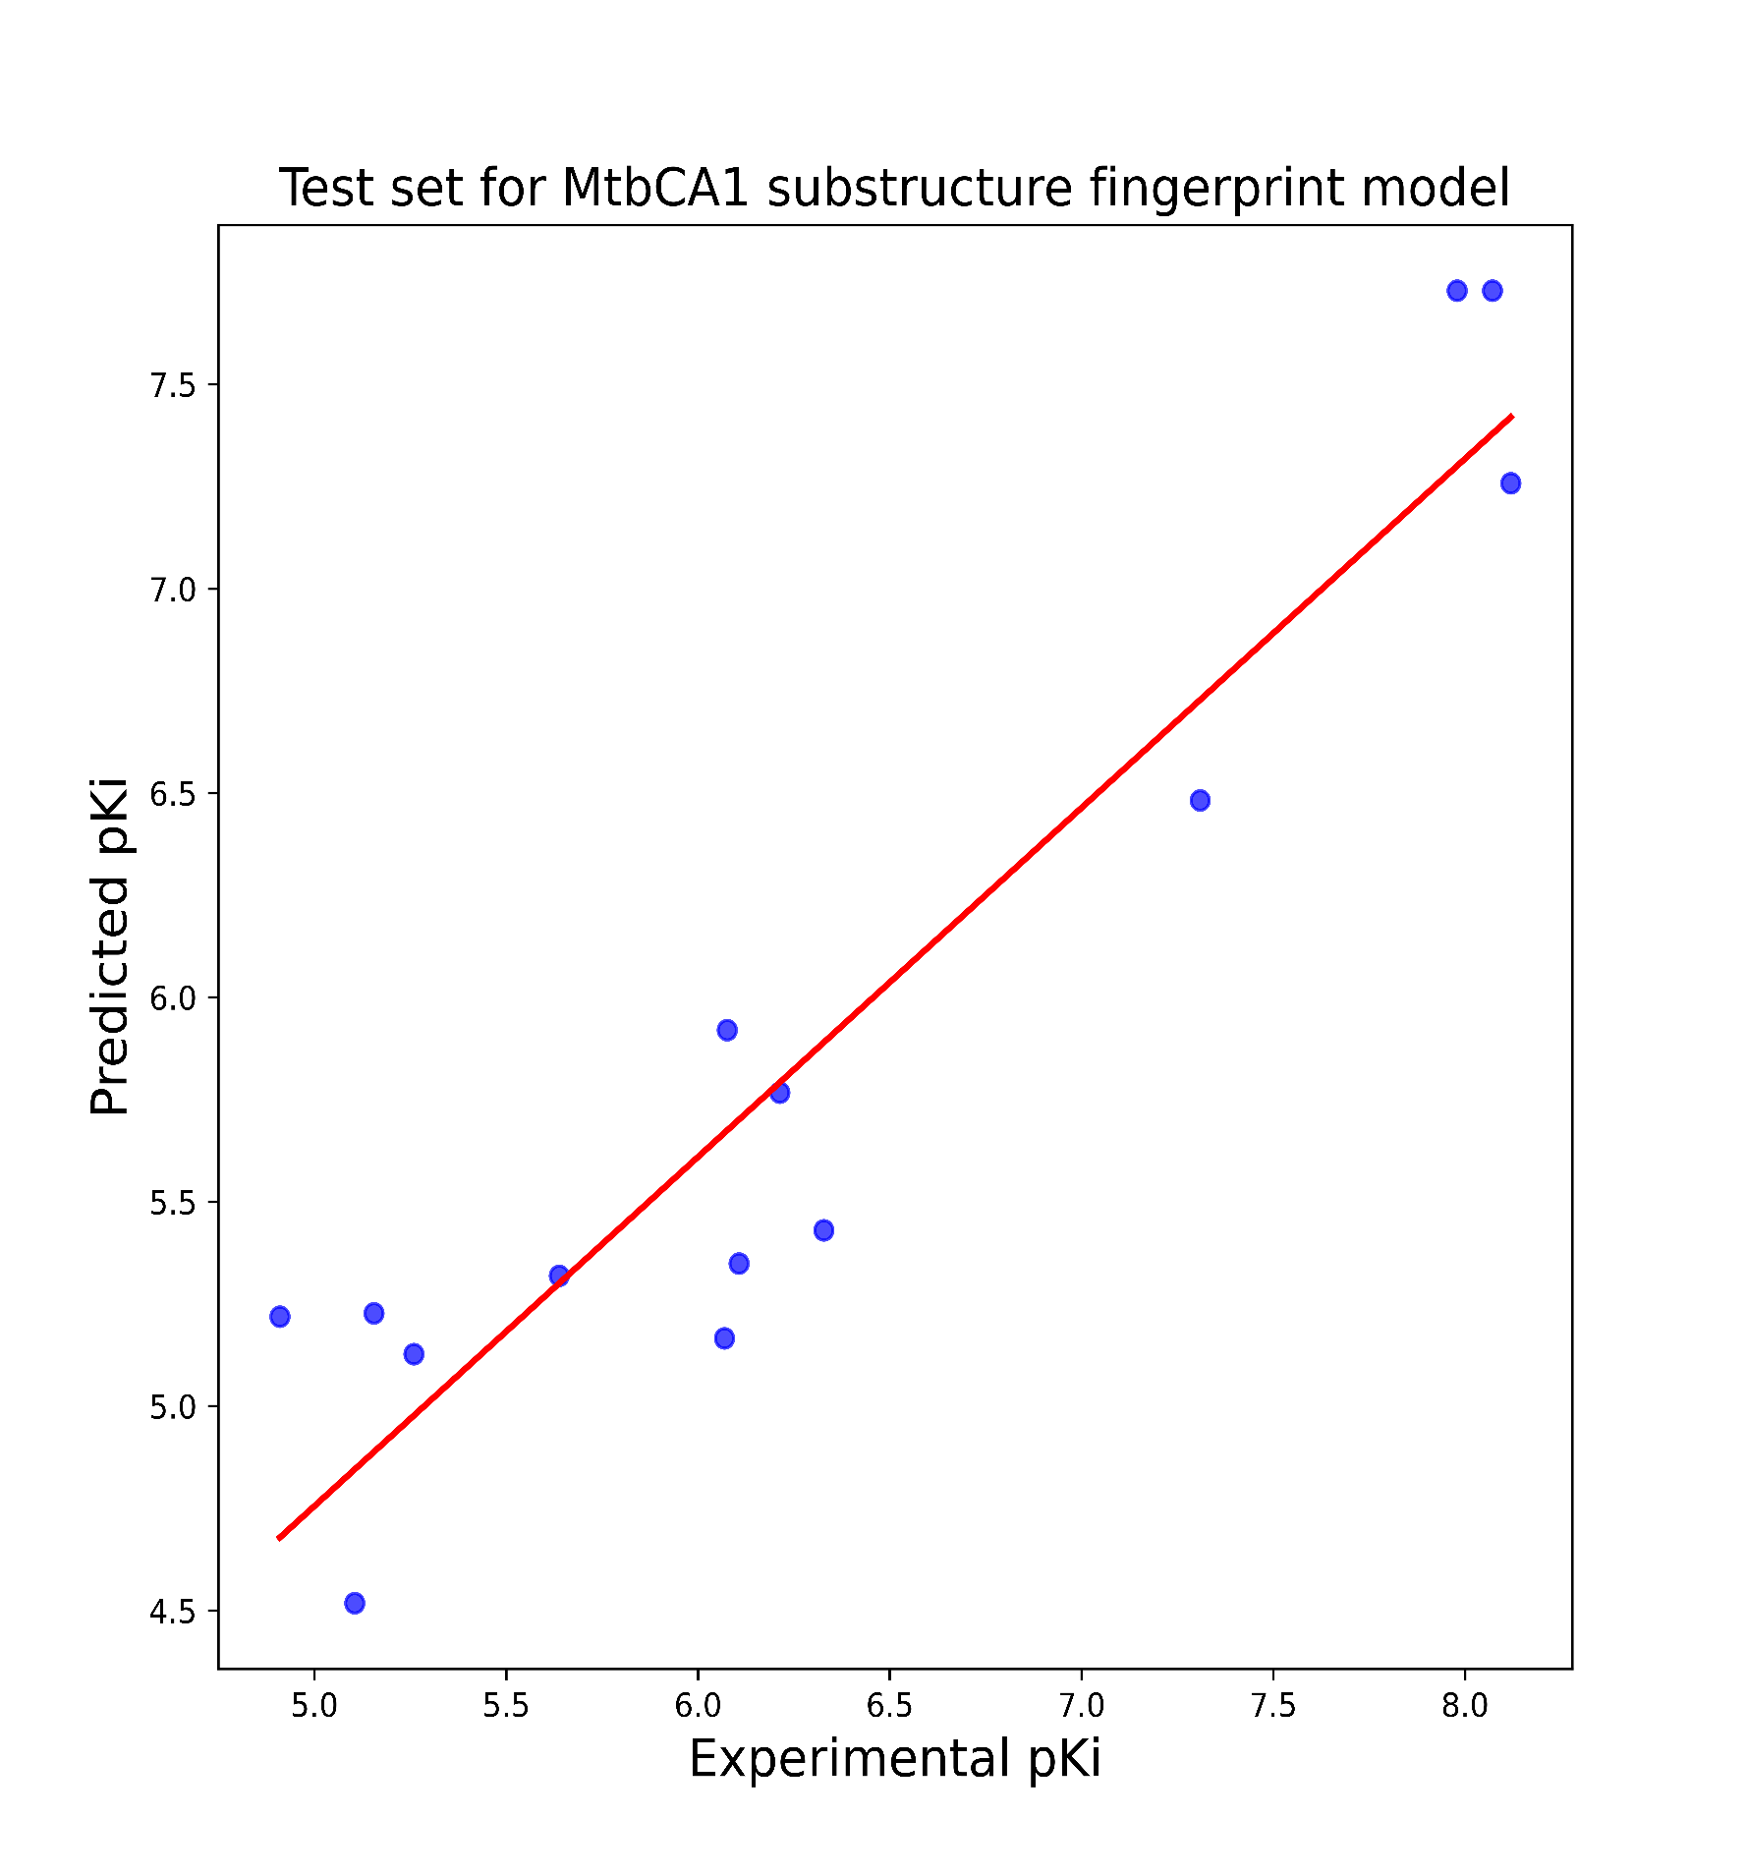
Model Metrics
R2: 0.955
RMSE: 0.3073
MAE: 0.2367
R2 (10 CV): 0.7661
Model Metrics
R2: 0.9406
RMSE: 0.5725
MAE: 0.4899

Slide 15


VIP plot and correlation matrix analysis for MtbCA1 substructure prediction model

Slide 16
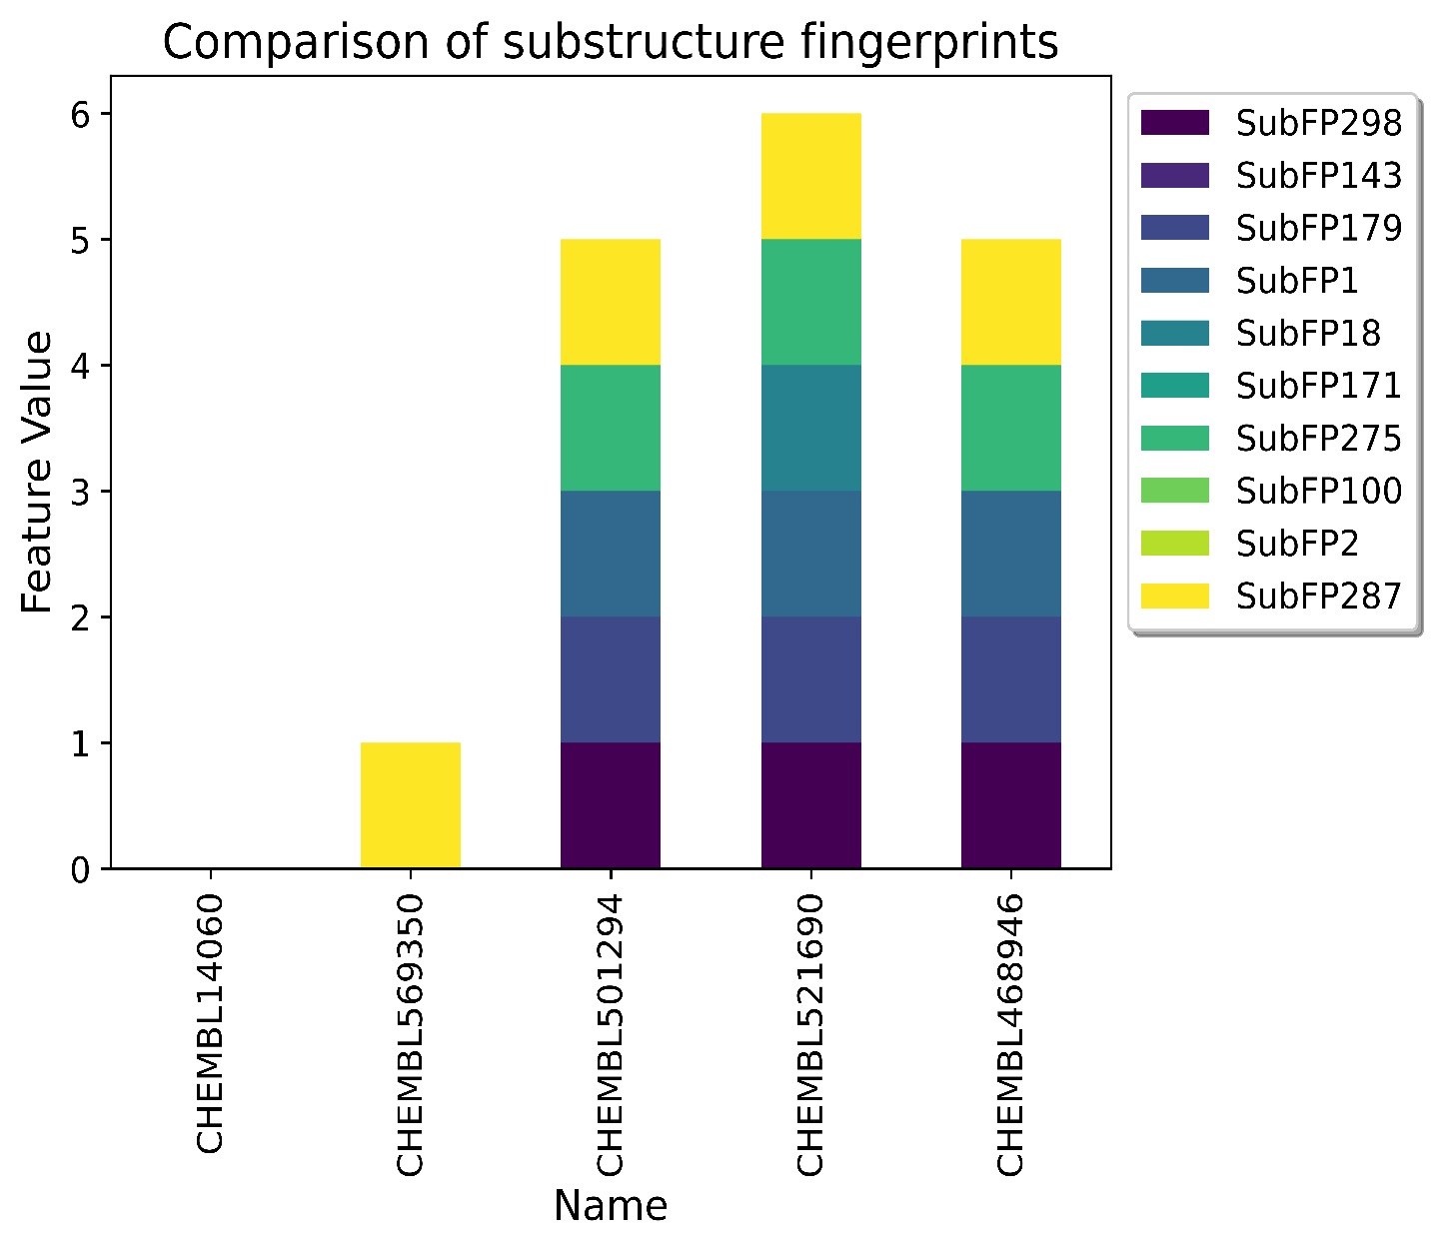
SubFP298 | Cation
SubFP143 | Carbonic acid derivatives
SubFP179 | Hetero N basic H
SubFP1 | Primary carbon
SubFP18 | Alkylarylether
SubFP171 | Arylchloride
SubFP275 | Heterocyclic
SubFP100 | Secondary amide
SubFP2 | Secondary carbon
SubFP287 | Conjugated double bond
CHEMBL569350 (Inactive)
CHEMBL14060 (Inactive)
Exp. pKi:4.201 Pred. pKi:4.518
Exp. pKi:4.194 Pred. pKi:4.706
CHEMBL468946 (Active)
CHEMBL521690 (Active)
CHEMBL501294 (Active)
Exp. pKi:8.292 Pred. pKi:7.729
Exp. pKi:8.066 Pred. pKi:7.941
Exp. pKi:8.013 Pred. pKi:7.729

Slide 17
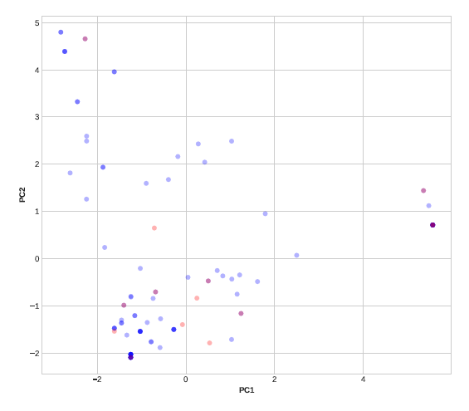
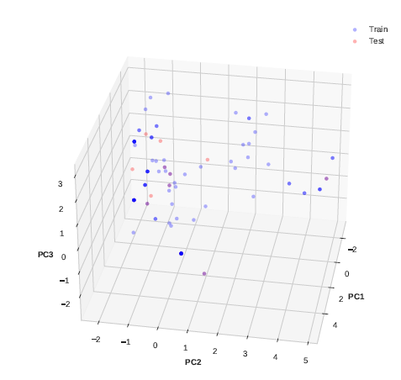
Applicability domain analysis through 2D and 3D PCA plots for MtbCA1 substructure prediction model

Slide 18
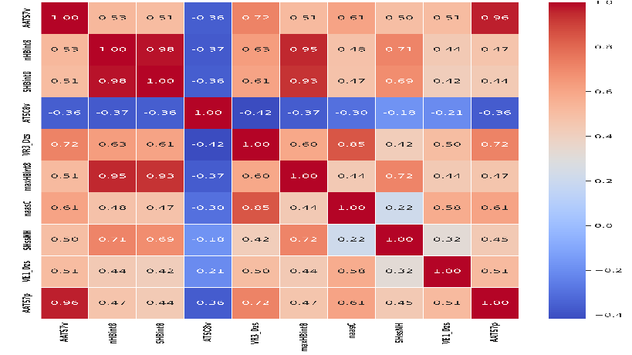
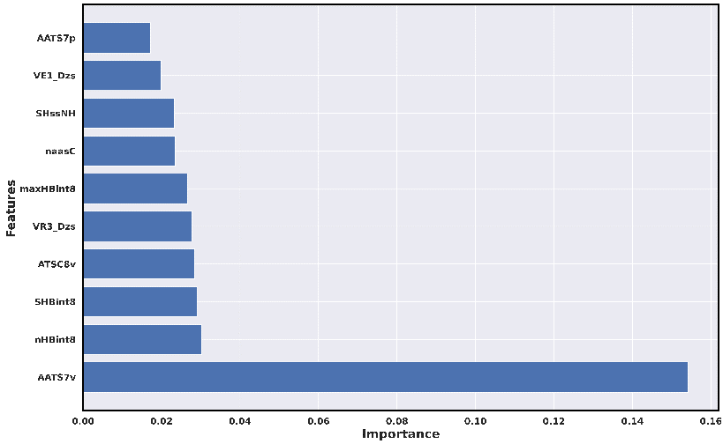
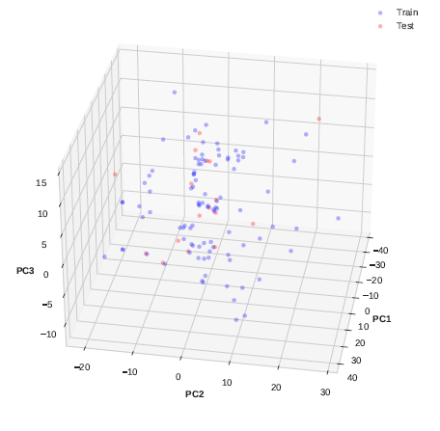
ML-QSAR model for bioactivity prediction of MtbCA1 inhibitors using 1D and 2D molecular descriptors
Model Metrics
R2 (Train: 0.9787, Test: 0.9333)
RMSE (Train: 0.2551,
Test: 0.4083)
MAE (Train: 0.2042, Test: 0.4899)
Correlation Matrix
Curation of MtbCA1 inhibitors with Ki value
Final Model Performance
Prediction Parameter: Bioactivity Class
(‘pKi’)
VIP Plot
The final machine-learning model
Total inhibitors:124
1D and 2D Molecular Descriptors:
1444
number of molecules in training(98) and test(17)
Dataset Splitting into training and test set
Elimination of highly correlated and constant fingerprints
Validation Metrics
Final number of descriptors(763), number of molecules in training(99) and test(25)
Random Forest Regressor
Model Metrics
R2 (Train: 0.9769, Test: 0.6047)
RMSE (Train: 0.2793, Test: 0.9688)
MAE (Train: 0.2134, Test: 0.7608)
FP and FN Removal
Initial Model Performance
Mention molecules removed (9)
Applicability Domain Analysis

Slide 19
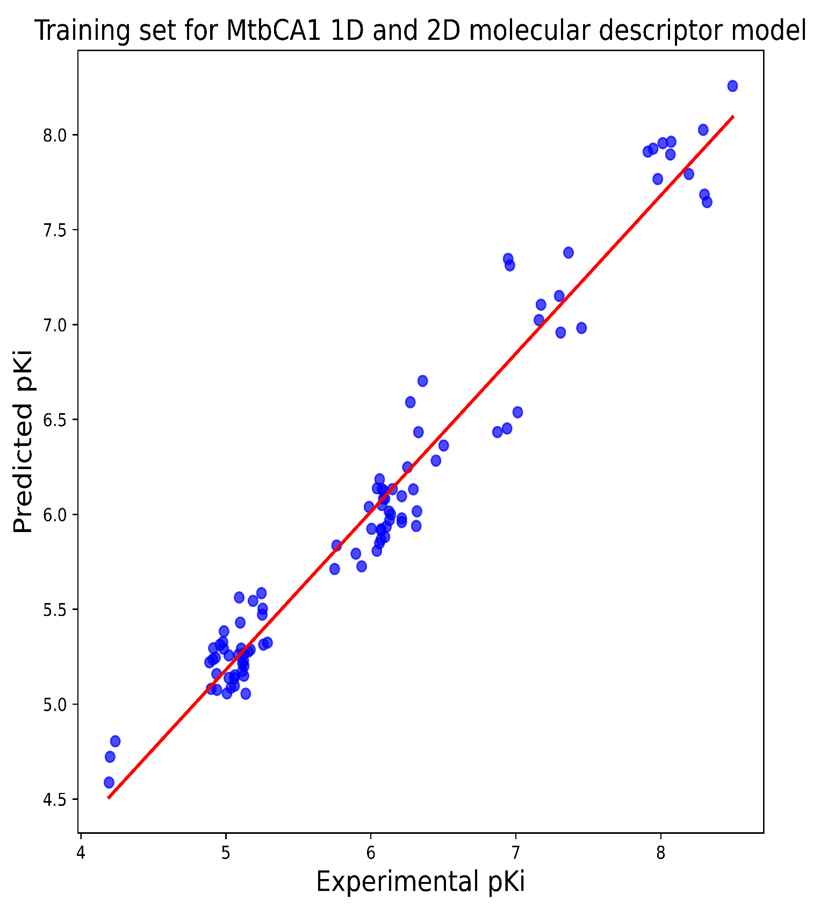
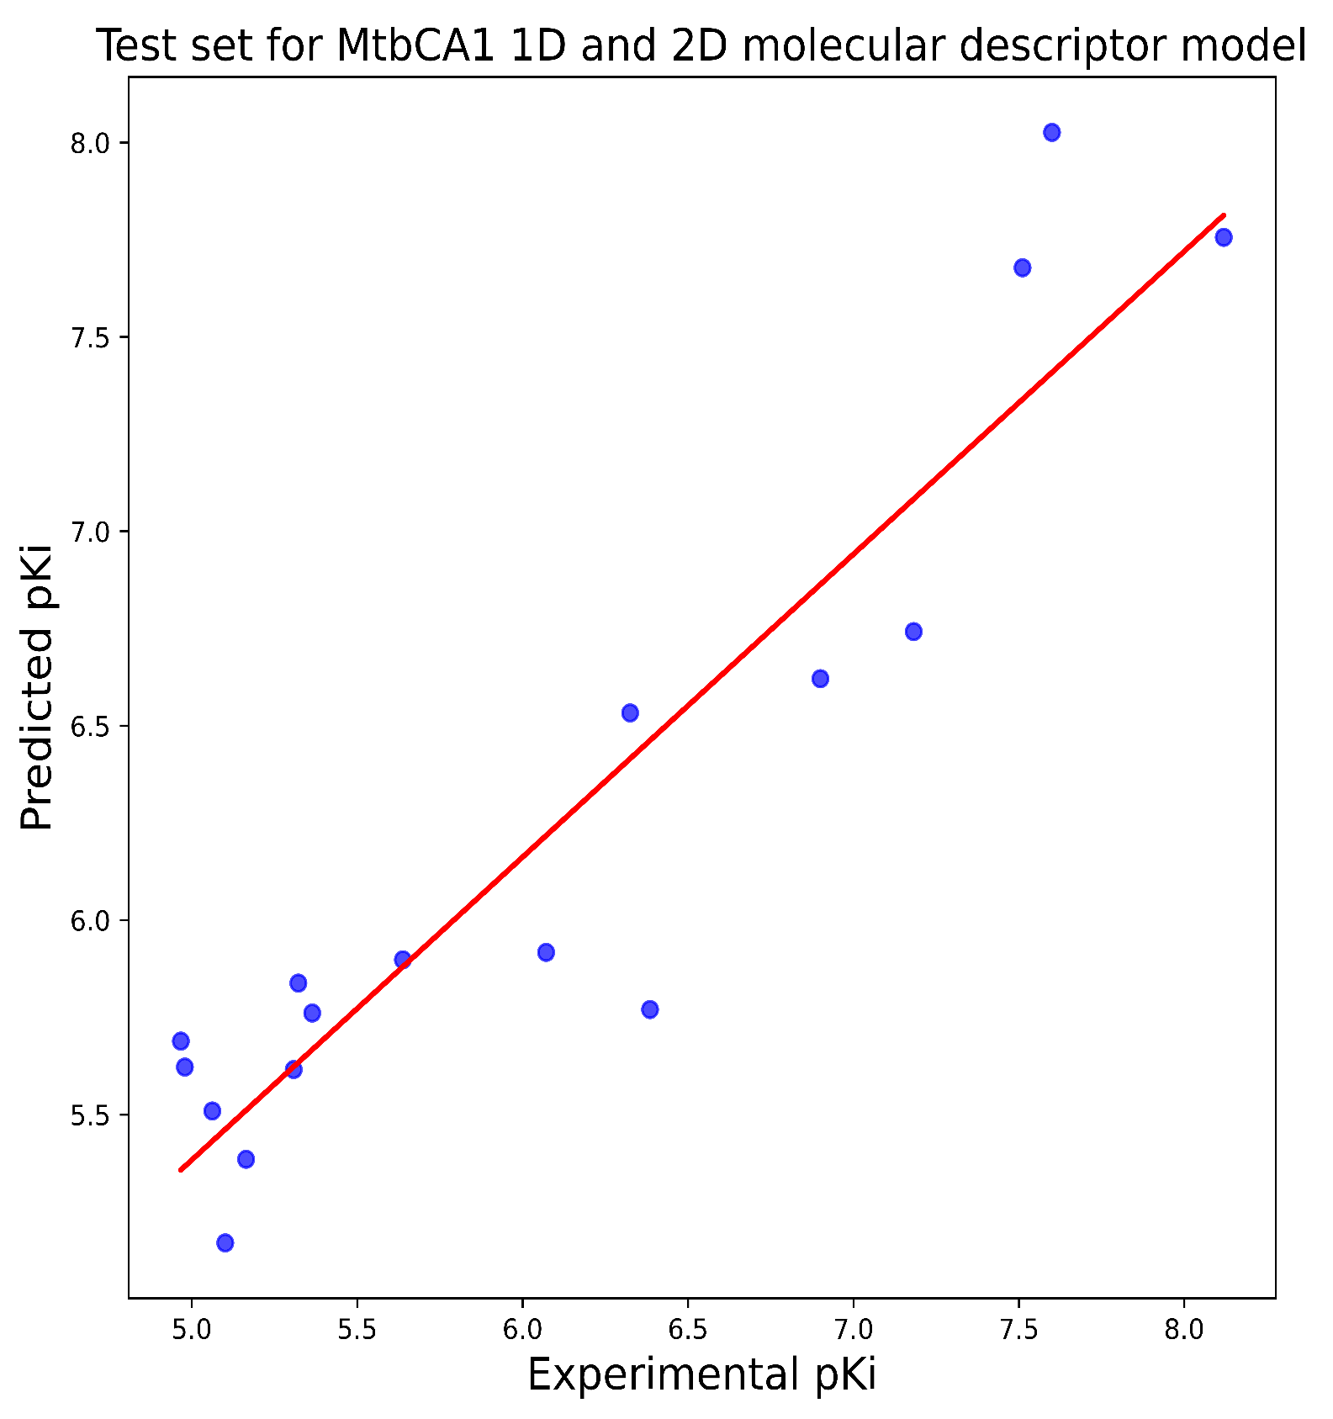
Model Metrics
R2: 0.9787
RMSE: 0.2551
MAE: 0.2042
R2 (10 CV): 0.7256
Model Metrics
R2: 0.9333
RMSE: 0.4083
MAE: 0.4899

Slide 20


VIP plot and correlation matrix analysis for MtbCA1 1D 2D molecular descriptor prediction model

Slide 21
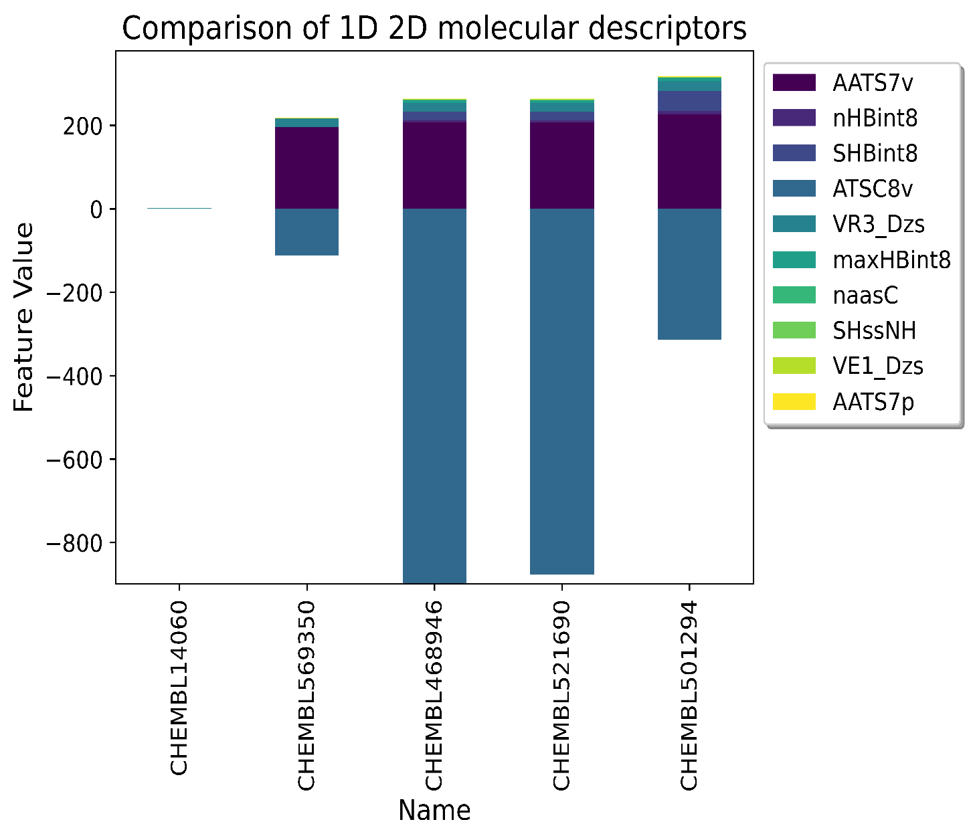
AATS7v | Average Broto-Moreau autocorrelation - lag 7 / weighted by van der Waals volumes
nHBint8 | Count of E-State descriptors of strength for potential Hydrogen Bonds of path length 8
SHBint8 | Sum of E-State descriptors of strength for potential hydrogen bonds of path length 8
ATSC8v | Centered Broto-Moreau autocorrelation - lag 8 / weighted by van der Waals volumes
VR3_Dzs | Logarithmic Randic-like eigenvector-based index from Barysz matrix / weighted by I-state
maxHBint8 | Maximum E-State descriptors of strength for potential Hydrogen Bonds of path length 8
naasC | Count of atom-type E-State: :C:-
SHssNH | Sum of atom-type H E-State: -NH-
VE1_Dzs | Coefficient sum of the last eigenvector from Barysz matrix / weighted by I-state
AATS7p | Average Broto-Moreau autocorrelation - lag 7 / weighted by polarizabilities
CHEMBL569350 (Inactive)
CHEMBL14060 (Inactive)
Exp. pKi:4.201 Pred. pKi:4.723
Exp. pKi:4.194 Pred. pKi:4.587
CHEMBL468946 (Active)
CHEMBL521690 (Active)
CHEMBL501294 (Active)
Exp. pKi:8.292 Pred. pKi:8.026
Exp. pKi:8.066 Pred. pKi:7.896
Exp. pKi:8.013 Pred. pKi:7.956

Slide 22
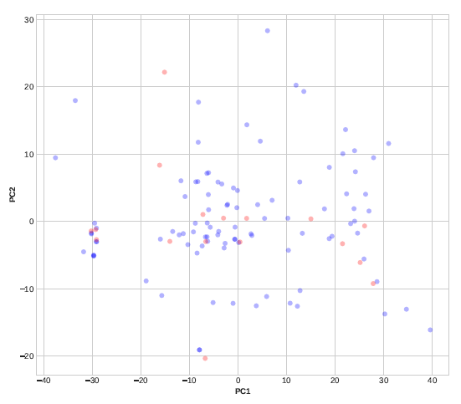
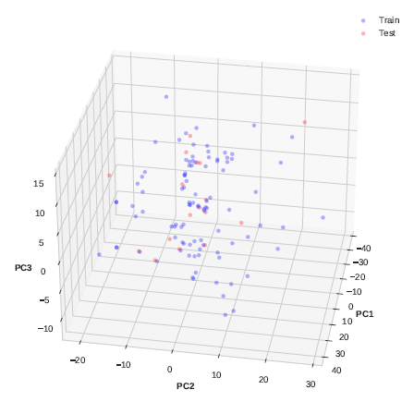
Applicability domain analysis through 2D and 3D PCA plots for MtbCA1 1D 2D molecular descriptor prediction model

Slide 23
MtbCA2 Prediction Model

Slide 24
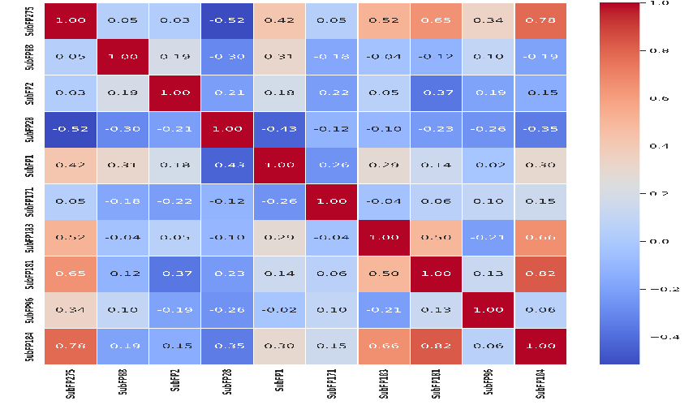
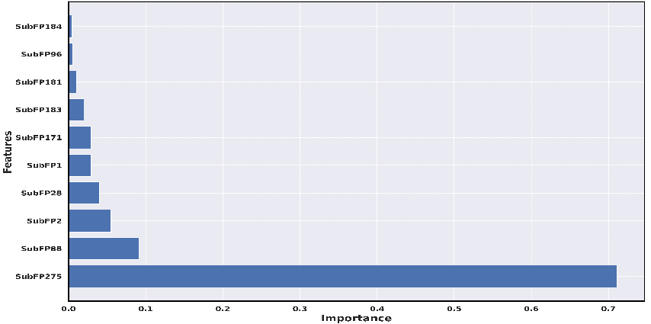
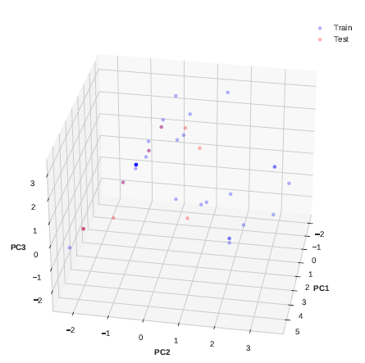
ML-QSAR model for bioactivity prediction of MtbCA2 inhibitors using substructure fingerprints
Model Metrics
R2 (Train: 0.9645, Test: 0.8764)
RMSE (Train: 0.2785,
Test: 0.5463)
MAE (Train: 0.1948, Test: 0.4097)
Correlation Matrix
Curation of MtbCA2 inhibitors with Ki value
Final Model Performance
Prediction Parameter: Bioactivity Class
(‘pKi’)
VIP Plot
The final machine-learning model
Total inhibitors:42
Substructure fingerprints:
307
number of molecules in training(33) and test(9)
Dataset Splitting into training and test set
Elimination of highly correlated and constant molecular descriptors
Validation Metrics
Final number of fingerprints(13), number of molecules in training(33) and test(9)
Random Forest Regressor
Model Metrics
R2 (Train: 0.9645, Test: 0.8764)
RMSE (Train: 0.2785, Test: 0.5463)
MAE (Train: 0.1948, Test: 0.4097)
FP and FN Removal
Initial Model Performance
Mention molecules removed (0)
Applicability Domain Analysis

Slide 25
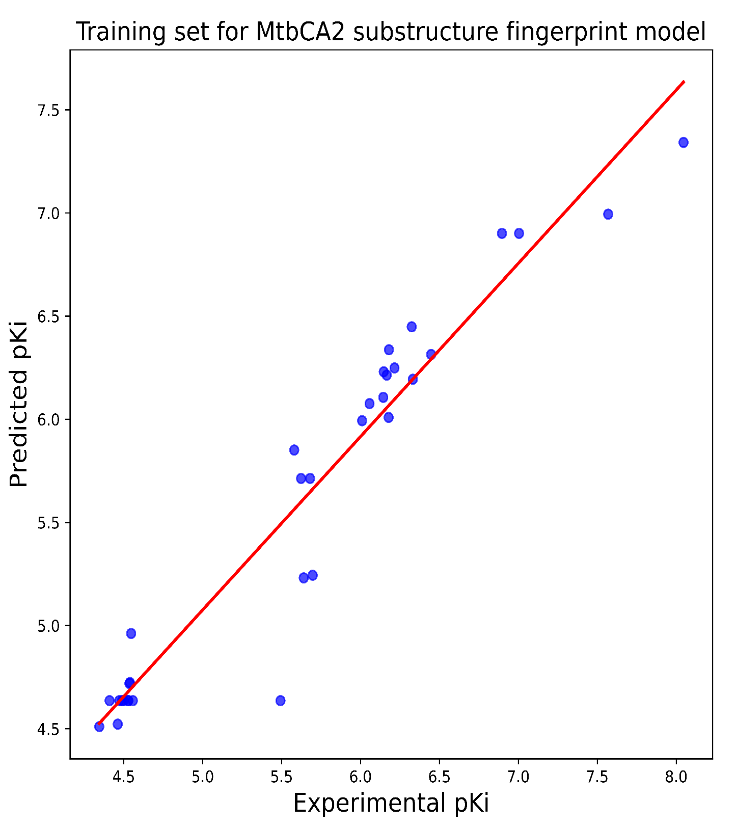
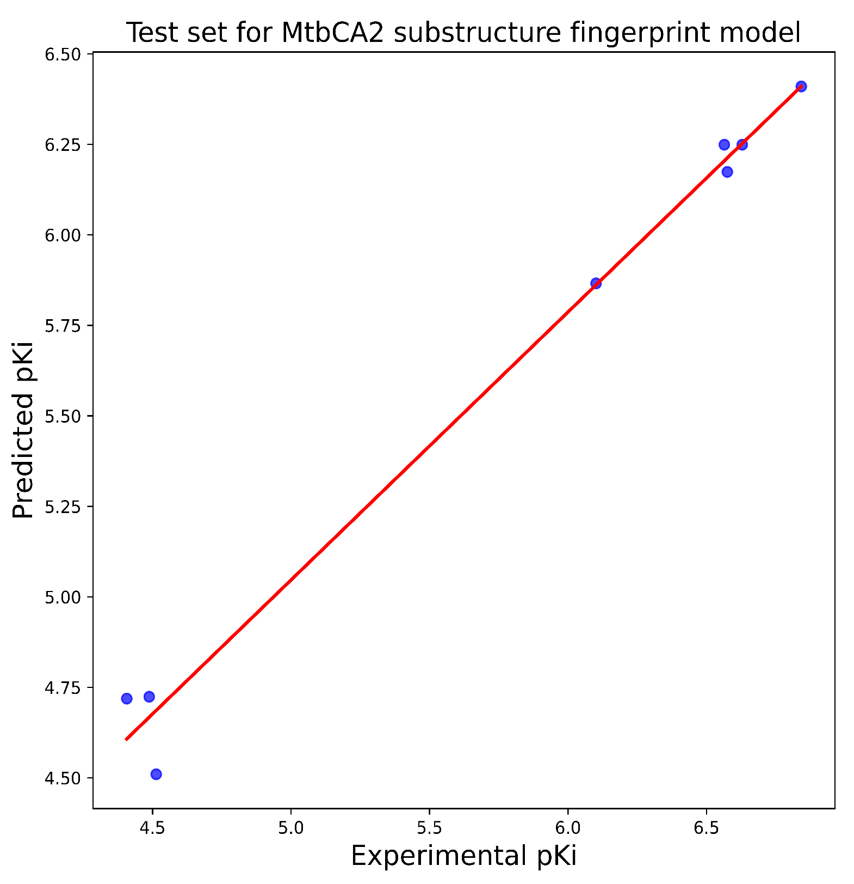
Model Metrics
R2: 0.9645
RMSE: 0.2785
MAE: 0.1948
R2 (10 CV): 0.7865
Model Metrics
R2: 0.8764
RMSE: 0.5463
MAE: 0.4097

Slide 26
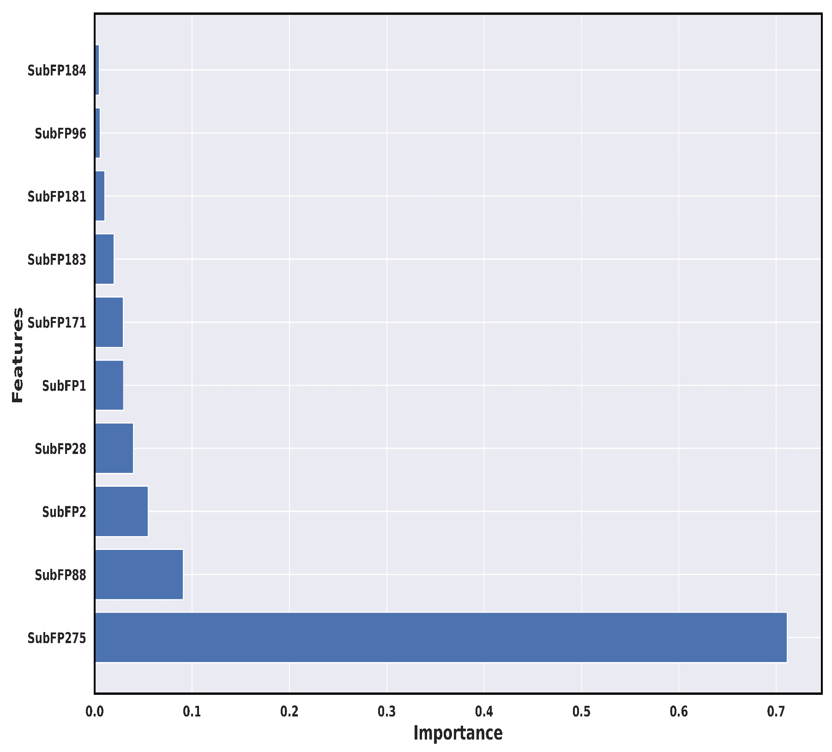

VIP plot and correlation matrix analysis for MtbCA2 substructure prediction model

Slide 27
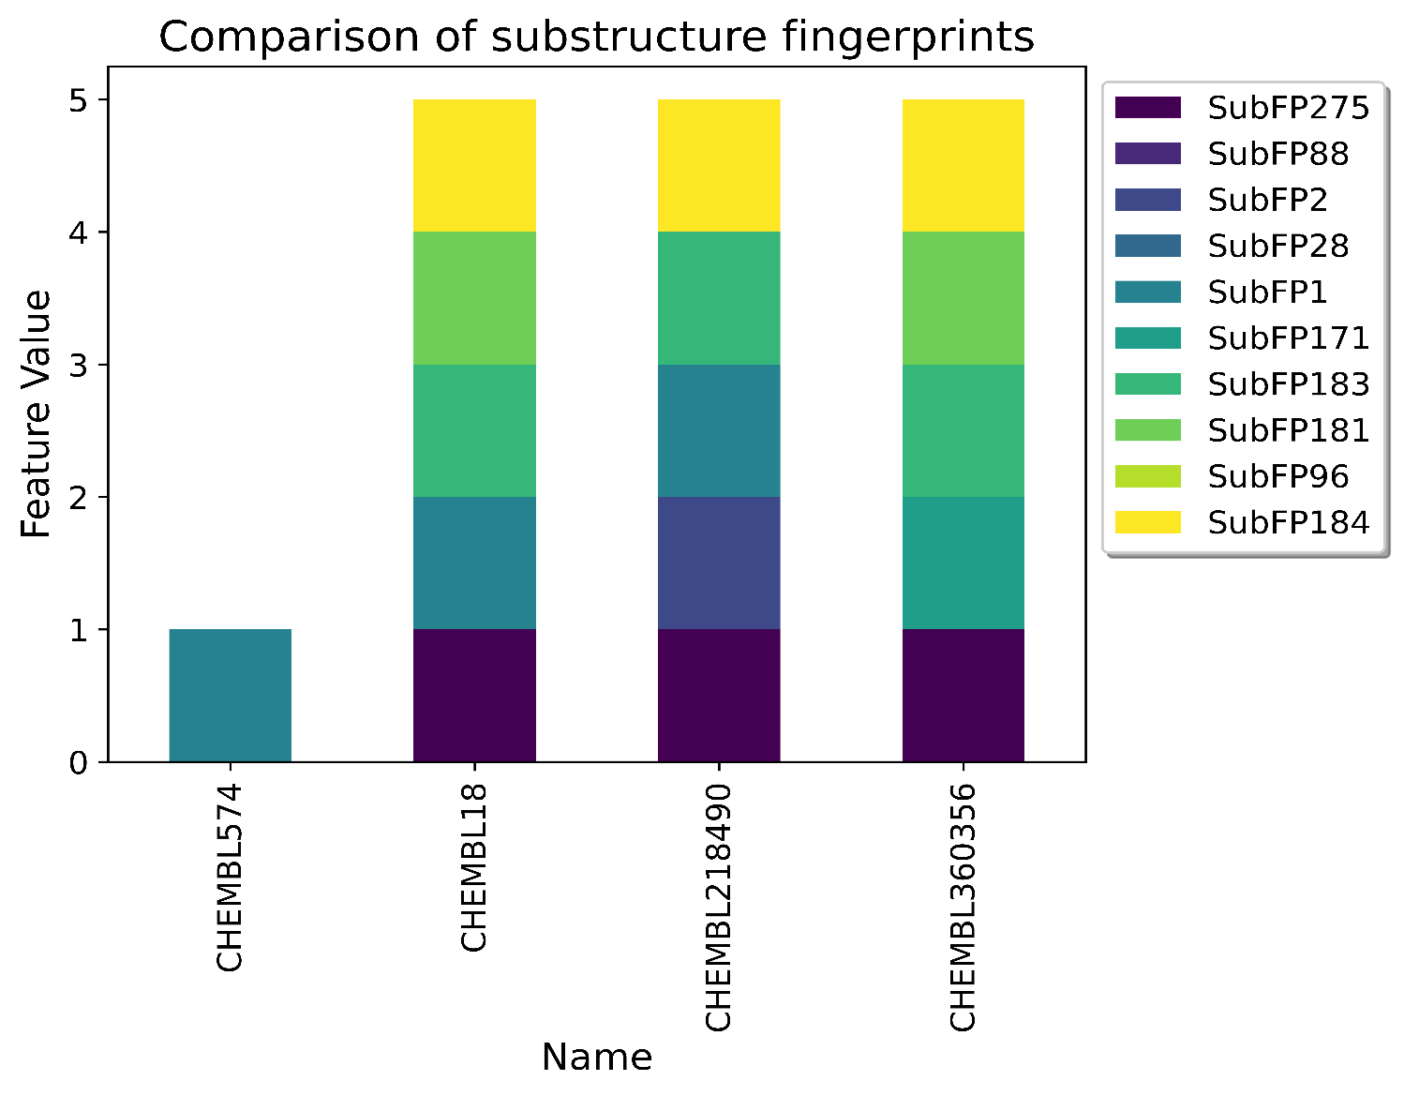
SubFP275 | Heterocyclic
SubFP88 | Carboxylic acid derivative
SubFP2 | Secondary carbon
SubFP28 | Primary aromatic amine
SubFP1 | Primary carbon
SubFP171 | Arylchloride
SubFP183 | Hetero S
SubFP181 | Hetero N nonbasic
SubFP96 | Carbodithioic ester
SubFP184 | Heteroaromatic
CHEMBL18/Ethoxzolamide
(Active)
CHEMBL218490/Dorzolamide
(Active)
CHEMBL574/P-Toluenesulfonamide
(Inactive)
CHEMBL360356/Chlorzolamide
(Inactive)
Exp. pKi:7.569 Pred. pKi:6.994
Exp. pKi:7.004 Pred. pKi:6.901
Exp. pKi:4.41 Pred. pKi:4.636
Exp. pKi:4.345 Pred. pKi:4.51

Slide 28
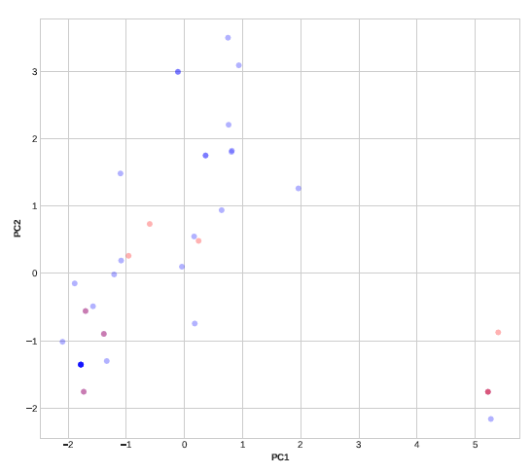
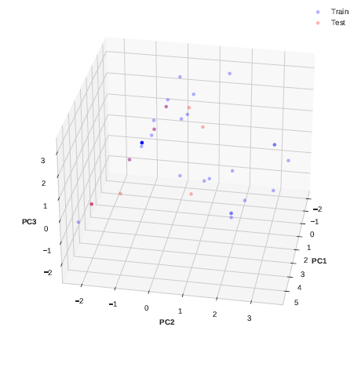
Applicability domain analysis through 2D and 3D PCA plots for MtbCA2 substructure prediction model

Slide 29
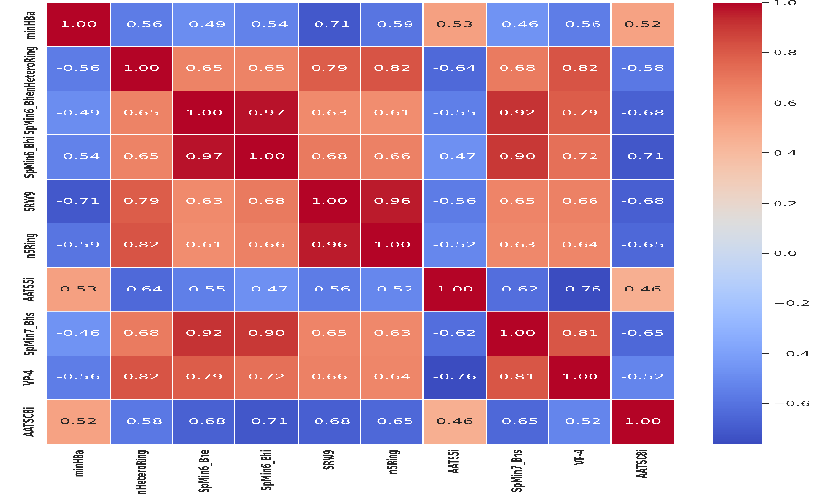
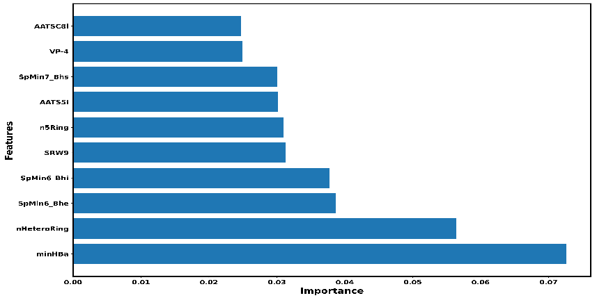
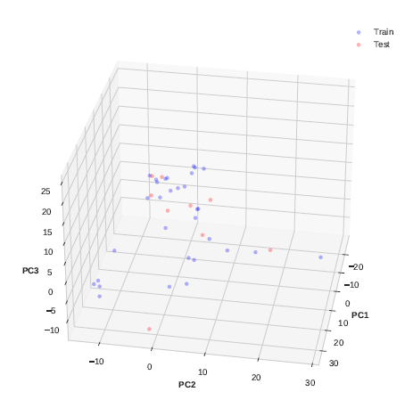
ML-QSAR model for bioactivity prediction of MtbCA2 inhibitors using 1D and 2D molecular descriptors
Model Metrics
R2 (Train: 0.9864, Test: 0.8874)
RMSE (Train: 0.1971,
Test: 0.4122)
MAE (Train: 0.1553, Test: 0.3101)
Correlation Matrix
Curation of MtbCA2 inhibitors with Ki value
Final Model Performance
Prediction Parameter: Bioactivity Class
(‘pKi’)
VIP Plot
The final machine-learning model
Total inhibitors:42
1D and 2D Molecular Descriptors:
1444
number of molecules in training(31) and test(9)
Dataset Splitting into training and test set
Elimination of highly correlated and constant molecular descriptors
Validation Metrics
Final number of descriptors(736), number of molecules in training(33) and test(9)
Random Forest Regressor
Model Metrics
R2 (Train: 0.9651, Test: 0.8572)
RMSE (Train: 0.326, Test: 0.4517)
MAE (Train: 0.2082, Test: 0.3368)
FP and FN Removal
Initial Model Performance
Mention molecules removed (0)
Applicability Domain Analysis

Slide 30
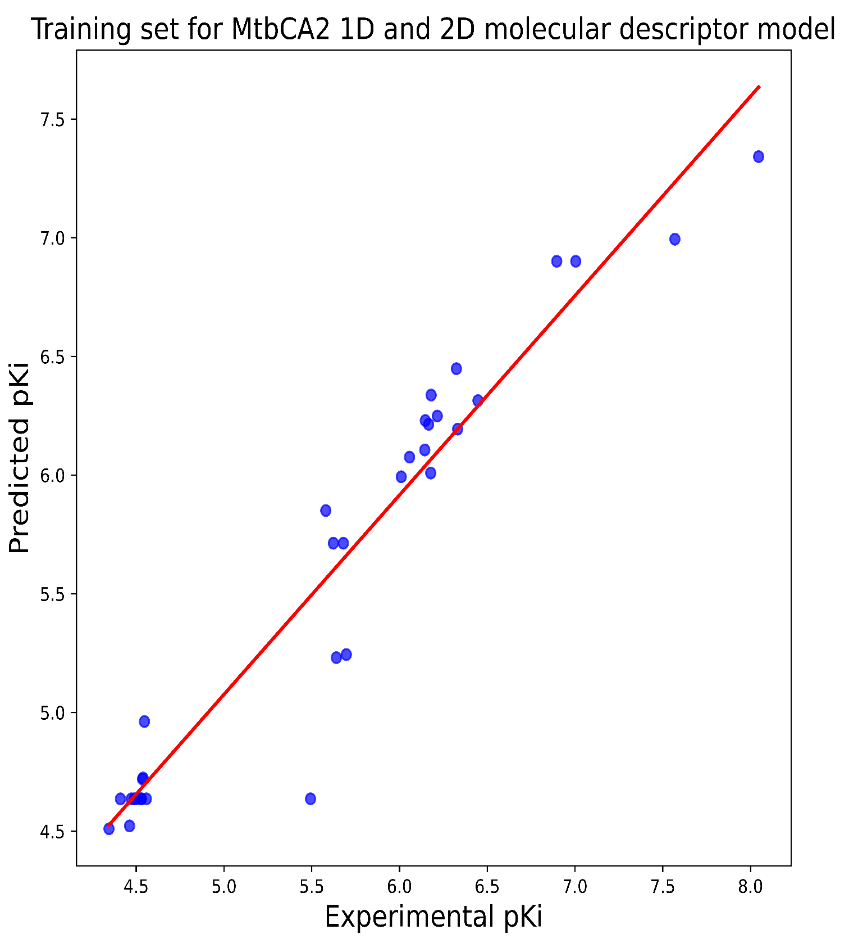
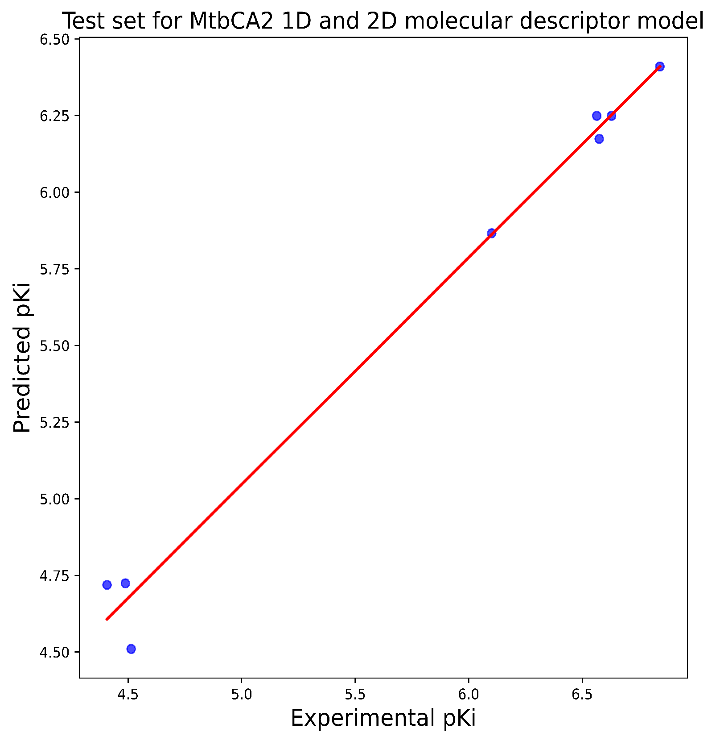
Model Metrics
R2: 0.9864
RMSE: 0.1971
MAE: 0.1553
R2 (10 CV): 0.7796
Model Metrics
R2: 0.8874
RMSE: 0.4122
MAE: 0.3101

Slide 31
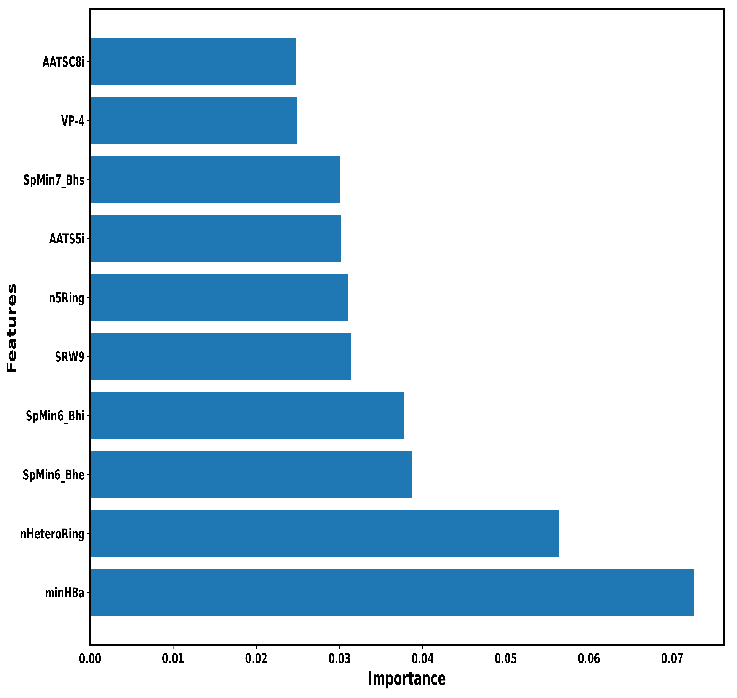

VIP plot and correlation matrix analysis for MtbCA2 1D 2D molecular descriptor prediction model

Slide 32
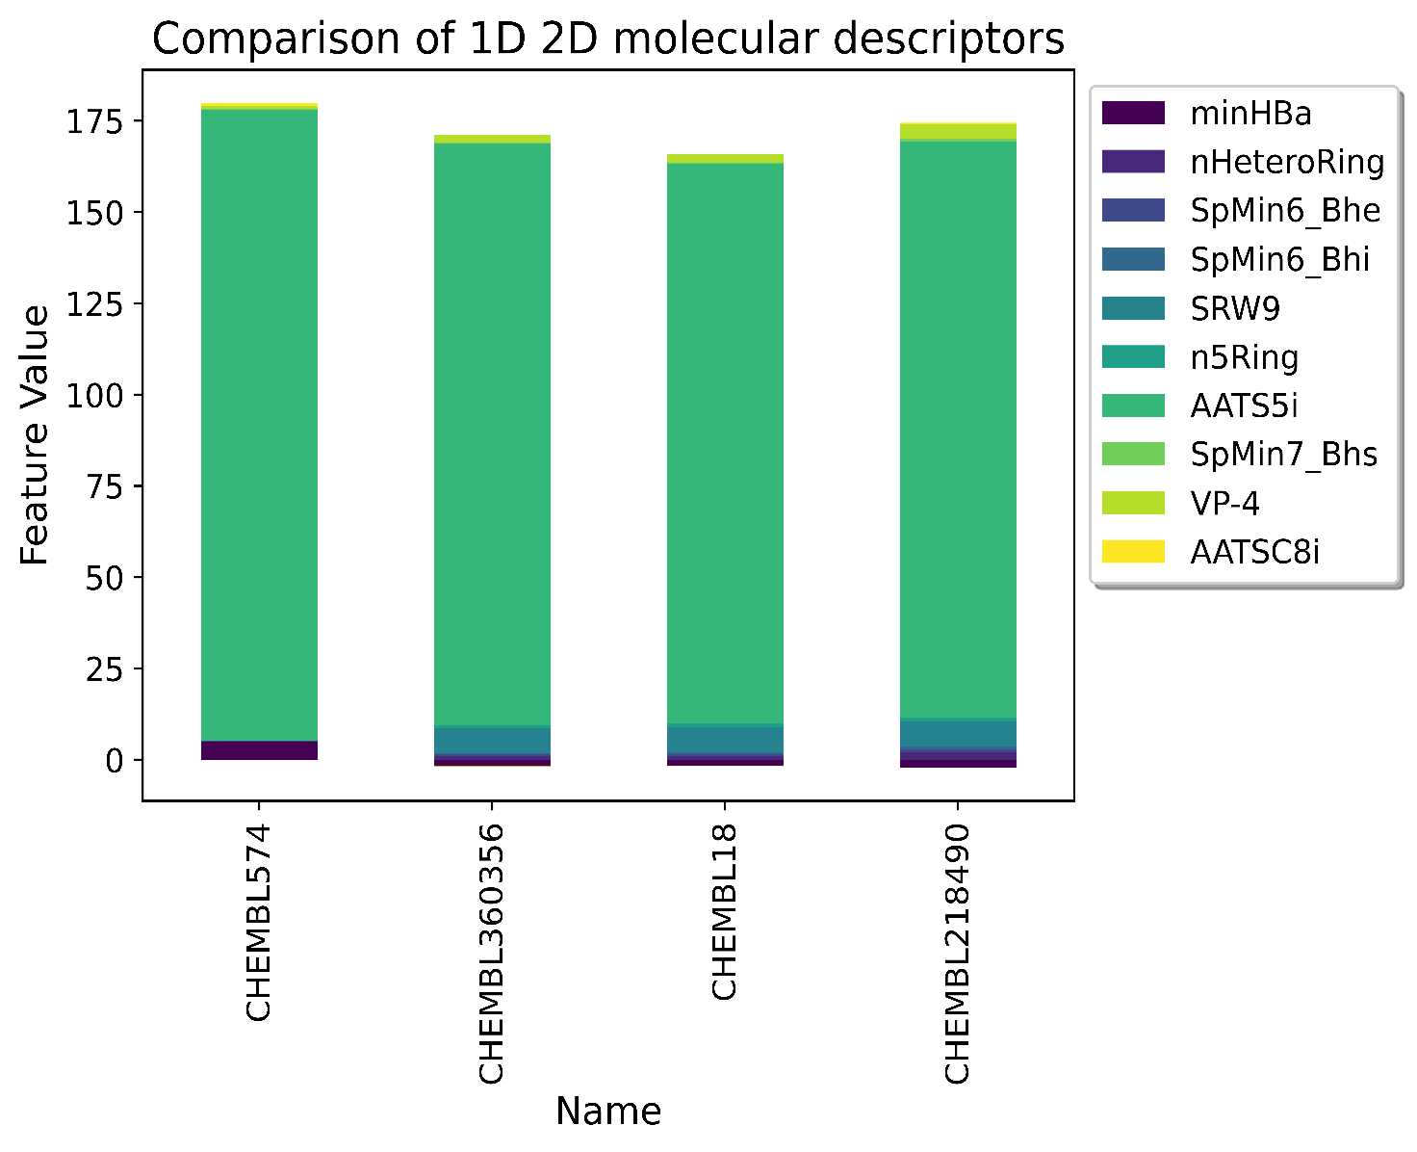
minHBa | Minimum E-States for (strong) Hydrogen Bond acceptors
nHeteroRing | Number of rings containing heteroatoms (N, O, P, S, or halogens)
SpMin6_Bhe | Smallest absolute eigenvalue of Burden modified matrix - n 6 / weighted by relative Sanderson electronegativities
SpMin6_Bhi | Smallest absolute eigenvalue of Burden modified matrix - n 6 / weighted by relative first ionization potential
SRW9 | Self-returning walk count of order 9 (ln(1+x)
n5Ring | Number of 5-membered rings
AATS5i | Average Broto-Moreau autocorrelation - lag 5 / weighted by first ionization potential
SpMin7_Bhs | Smallest absolute eigenvalue of Burden modified matrix - n 7 / weighted by relative I-state
VP-4 | Valence path, order 4
AATSC8i | Average centered Broto-Moreau autocorrelation - lag 8 / weighted by first ionization potential
CHEMBL18/Ethoxzolamide
(Active)
CHEMBL218490/Dorzolamide
(Active)
CHEMBL574/P-Toluenesulfonamide
(Inactive)
CHEMBL360356/Chlorzolamide
(Inactive)
Exp. pKi:7.569 Pred. pKi:6.823
Exp. pKi:7.004 Pred. pKi:6.784
Exp. pKi:4.41 Pred. pKi:4.907
Exp. pKi:4.345 Pred. pKi:4.491

Slide 33
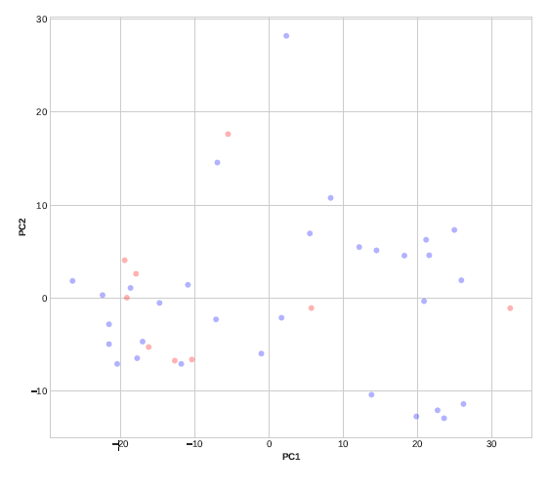
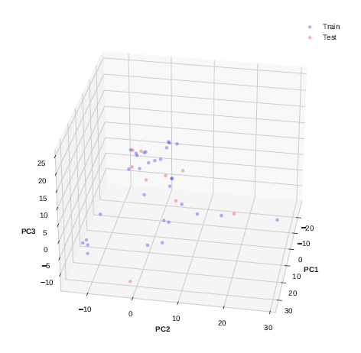
Applicability domain analysis through 2D and 3D PCA plots for MtbCA2 1D 2D molecular descriptor prediction model

Slide 35
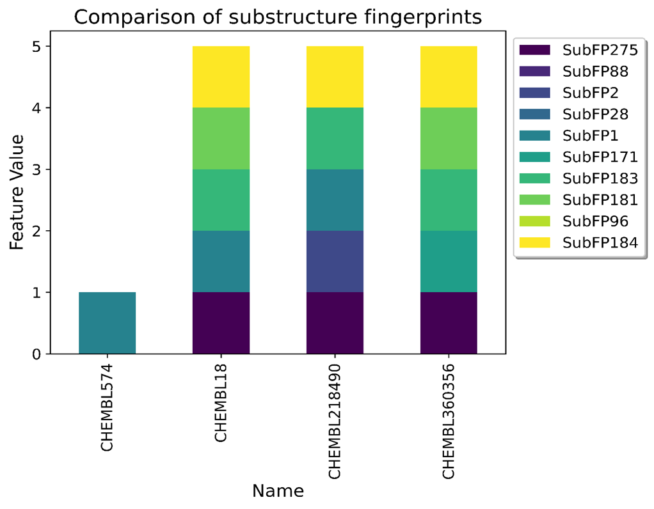
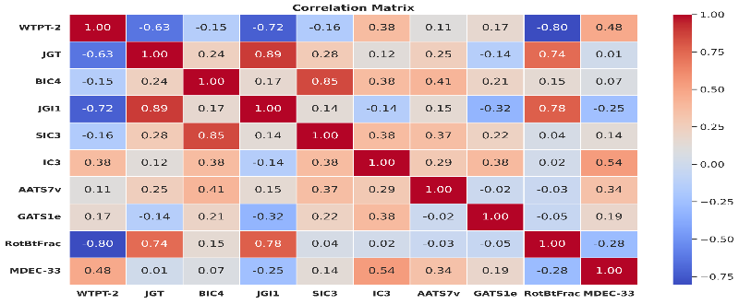


Initial ML-QSAR models deployment using two different molecular signatures with respect to MtbCA1 inhibitors with their respective pKi values)
(S: 307 ; D: 1444)
ML-QSAR models generation and statistical analysis
(S:18; D:763)
Machine Learning models generation with significant molecular signatures
Web app
development
Initial ML-QSAR models deployment using two different molecular signatures with respect to MtbCA2 inhibitors with their respective pKi values)
(S: 307 ; D: 1444)
ML-QSAR models generation and statistical analysis
(S:13; D:736)
Machine Learning models generation with significant molecular signatures
Web app
development
ML-QSAAR
(Dual inhibitors)
MtbCA-Selec-Pred
https://mtbca-selec-pred.streamlit.app/
Machine Learning-assisted web application for selectivity bioactivity prediction for MtbCAIs, against MtbCA1 and MtbCA2
S: Substructure Fingerprints D: 1D & 2D Descriptors

Slide 36
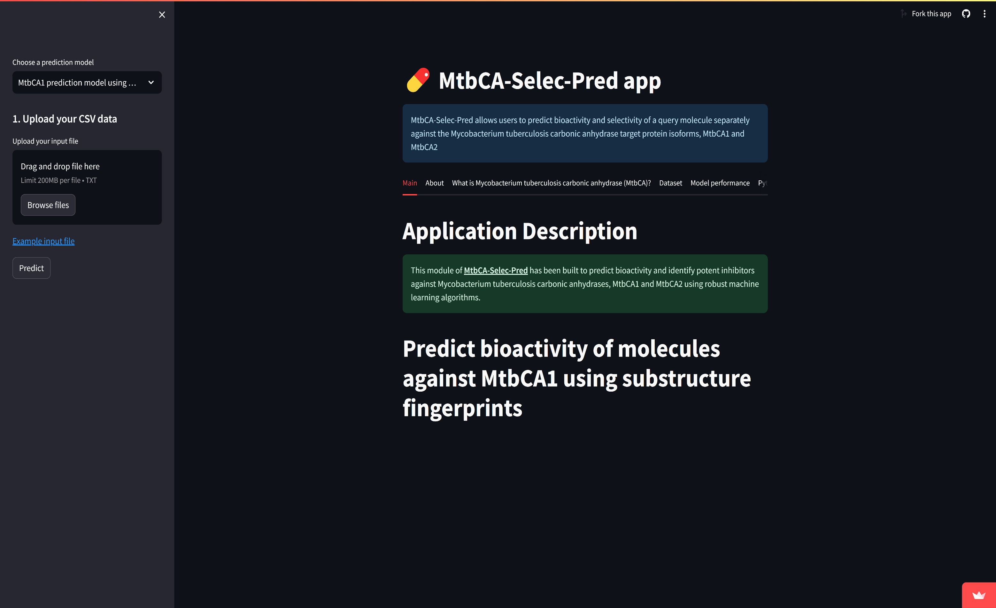

Slide 37
MACHINE LEARNING ASSISTED QUANTITATIVE STRUCTURAL ACTIVITY-ACTIVITY RELATIONSHIP

Slide 38


Curation of 42 molecules with activity (Ki) against both MtbCA1 and MtbCA2
VIP plot of 20 best features for pKi_mtbca1 prediction
VIP plot of 20 best features for pKi_mtbca2 prediction
Calculation of 1D and 2D Molecular Descriptors (1444)
Elimination of highly correlated and constant molecular descriptors combined with VIP selection
Selection of significant descriptors
Feature importance score >0.02
Feature importance score >0.02
Selection of significant descriptors
ML-QSAAR models
Significant 1D 2D molecular descriptors + pKi_mtbca2
Significant 1D 2D molecular descriptors + pKi_mtbca1
pKi_mtbca1
pKi_mtbca2

Slide 39



ML-QSAAR model for bioactivity prediction of MtbCA1 inhibitors using 1D and 2D molecular descriptors
Model Metrics
R2 (Train: 0.9789, Test: 0.794)
RMSE (Train: 0.122,
Test: 0.4878)
MAE (Train: 0.0904, Test: 0.3647)
Correlation Matrix
Curation of 42 (MtbCA1 + MtbCA2) inhibitors with Ki value
Final Model Performance
Prediction Parameter: Bioactivity Class
(‘pKi’)
VIP Plot
The final machine-learning model
Total inhibitors:42
1D and 2D Molecular Descriptors:
1444
number of molecules in training(32) and test(8)
Dataset Splitting into training and test set
Elimination of highly correlated and constant molecular descriptors
Validation Metrics
Final number of descriptors(7), number of molecules in training(33) and test(9)
MLP Regressor
Model Metrics
R2 (Train: 0.9187, Test: 0.4816)
RMSE (Train: 0.2439, Test: 0.6908)
MAE (Train: 0.1691, Test: 0.5028)
FP and FN Removal
Initial Model Performance
Mention molecules removed (2)
Applicability Domain Analysis

Slide 40


Model Metrics
R2: 0.9789
RMSE: 0.122
MAE: 0.0904
R2 (10 CV): 0.7393
Model Metrics
R2: 0.794
RMSE: 0.4878
MAE: 0.3647

Slide 41


VIP plot and correlation matrix analysis for MtbCA1 1D 2D molecular descriptor QSAAR prediction model

Slide 42
MtbCA1 inhibitors with MtbCA2 inhibition property
MtbCA1 inhibition signatures
Presence of SubFP1, SuFP179, SubFP287, SubFP100, nHBint8, SHBint8, naasC, and SHssNH
ATSC2p
MLFER_S
ATSC4p
CHEMBL2179304
pKi (MtbCA1): 6.939 (Active)
pKi (MtbCA2): 6.842 (Active)
CHEMBL2179307
pKi (MtbCA1): 6.385 (Active)
pKi (MtbCA2): 6.628 (Active)
pKi
(MtbCA2)
AATSC4v
MtbCA2 inhibition signatures
Presence of SubFP275, SubFP28, SubFP1, SubFP183, SubFP184, minHBa, nHeteroRing, n5Ring
VE3_Dt
ATS1m
CHEMBL2179305
pKi (MtbCA1): 6.873 (Active)
pKi (MtbCA2): 6.318 (Active)
CHEMBL20 (Acetazolamide)
pKi (MtbCA1): 6.318 (Active)
pKi (MtbCA2): 8.046 (Active)
Positive values
Negative values
pKi (MtbCA2)
pKi (MtbCA1)

Slide 43


Applicability domain analysis through 2D and 3D PCA plots for MtbCA1 1D 2D molecular descriptor QSAAR prediction model

Slide 44



ML-QSAAR model for bioactivity prediction of MtbCA2 inhibitors using 1D and 2D molecular descriptors
Model Metrics
R2 (Train: 0.9916, Test: 0.9713)
RMSE (Train: 0.1585,
Test: 0.3641)
MAE (Train: 0.1222, Test: 0.2697)
Correlation Matrix
Curation of 42 (MtbCA1 + MtbCA2) inhibitors with Ki value
Final Model Performance
Prediction Parameter: Bioactivity Class
(‘pKi’)
VIP Plot
The final machine-learning model
Total inhibitors:42
1D and 2D Molecular Descriptors:
1444
number of molecules in training(33) and test(6)
Dataset Splitting into training and test set
Elimination of highly correlated and constant molecular descriptors
Validation Metrics
Final number of descriptors(7), number of molecules in training(33) and test(9)
MLP Regressor
Model Metrics
R2 (Train: 0.9916, Test: 0.8612)
RMSE (Train: 0.1585, Test: 0.7041)
MAE (Train: 0.1222, Test: 0.5742)
FP and FN Removal
Initial Model Performance
Mention molecules removed (2)
Applicability Domain Analysis

Slide 45


Model Metrics
R2: 0.9916
RMSE: 0.1585
MAE: 0.1222
R2 (10 CV): 0.8171
Model Metrics
R2: 0.9713
RMSE: 0.3641
MAE: 0.2697

Slide 46


VIP plot and correlation matrix analysis for MtbCA2 1D 2D molecular descriptor QSAAR prediction model
Descriptors | Interpretation
SpMin4_Bhs | Smallest absolute eigenvalue of Burden modified matrix - n 4 / weighted by relative I-state
SpMin7_Bhs | Smallest absolute eigenvalue of Burden modified matrix - n 7 / weighted by relative I-state
SpMin6_Bhi | Smallest absolute eigenvalue of Burden modified matrix - n 6 / weighted by relative first ionization potential
nHeteroRing | Number of rings containing heteroatoms (N, O, P, S, or halogens)
GATS7s | Geary autocorrelation - lag 7 / weighted by I-state
IC2 | Information content index (neighborhood symmetry of 2-order)
SRW9 | Self-returning walk count of order 9 (ln(1+x)
ATSC5v | Centered Broto-Moreau autocorrelation - lag 5 / weighted by van der Waals volumes
SpMAD_Dt | Spectral mean absolute deviation from detour matrix
GGI3 | Topological charge index of order 3
AATSC7v | Average centered Broto-Moreau autocorrelation - lag 7 / weighted by van der Waals volumes
pKi_mtbca1 | Inhibition activity against MtbCA1
AATSC4v | Average centered Broto-Moreau autocorrelation - lag 4 / weighted by van der Waals volumes
SRW5 | Self-returning walk count of order 5 (ln(1+x)

Slide 47
MtbCA2 inhibitors with MtbCA1 inhibition property
MtbCA1 inhibition signatures
Presence of SubFP1, SuFP179, SubFP287, SubFP143, SubFP100, nHBint8, SHBint8, naasC, and SHssNH
ATSC5v
GATS7s
pKi
(MtbCA1)
CHEMBL18 (Ethoxzolamide)
pKi (MtbCA2): 7.569 (Active)
pKi (MtbCA1): 5.99 (Moderate)
CHEMBL218490 (Dorzolamide)
pKi (MtbCA2): 7.004 (Active)
pKi (MtbCA1): 6.13 (Active)
SpMin6_Bhi
AATSC4v
SpMin4_Bhs
SpMin7_Bhs
MtbCA2 inhibition signatures
Presence of SubFP275, SubFP28, SubFP1, SubFP183, SubFP184, minHBa, nHeteroRing, n5Ring
SpMAD_Dt
AATSC7v
IC2
nHeteroRing
GGI3
CHEMBL20 (Acetazolamide)
pKi (MtbCA2): 8.046 (Active)
pKi (MtbCA1): 6.318 (Active)
SRW5
CHEMBL220491 (Brinzolamide)
pKi (MtbCA2): 6.896 (Active)
pKi (MtbCA1): 6.076 (Active)
SRW9
Positive values
Negative values
pKi (MtbCA2)
does not always imply
pKi (MtbCA1)

Slide 48

Applicability domain analysis through 2D and 3D PCA plots for MtbCA2 1D 2D molecular descriptor QSAAR prediction model

Slide 49


Slide 50

THANK YOU

